Slide 1




e-Atlas – Technical Overview
Data management and visualization for environmental research data
Eric Lawrey

Slide 2

Dr Eric Lawrey
Australian Institute of Marine Science
Worked on the e-Atlas since 2008
The e-Atlas system developer under MTSRF.
Now project leader (NERP TE), focus on:
  Data preparation
  Stakeholder and researcher engagement
  System design
Previously CTO of a software research company
B.E (Computer Systems), PhD. (modelling wireless communications)

Slide 3
Agenda
What is the e-Atlas?
Demonstration
Design and architecture
Importance of data and data management

Slide 4
What is the e-Atlas?

Slide 5
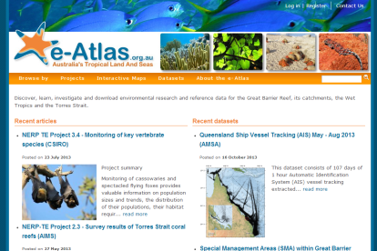
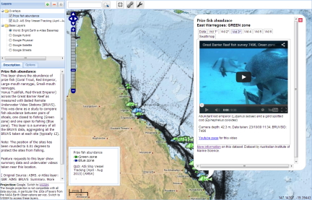
What is the e-Atlas?
Website and mapping system for making environmental research available online.
Intended to improve access and use of science.
  Researchers, Managers, Public
Maps, data, meta-data, visualization tools, articles.

Slide 6
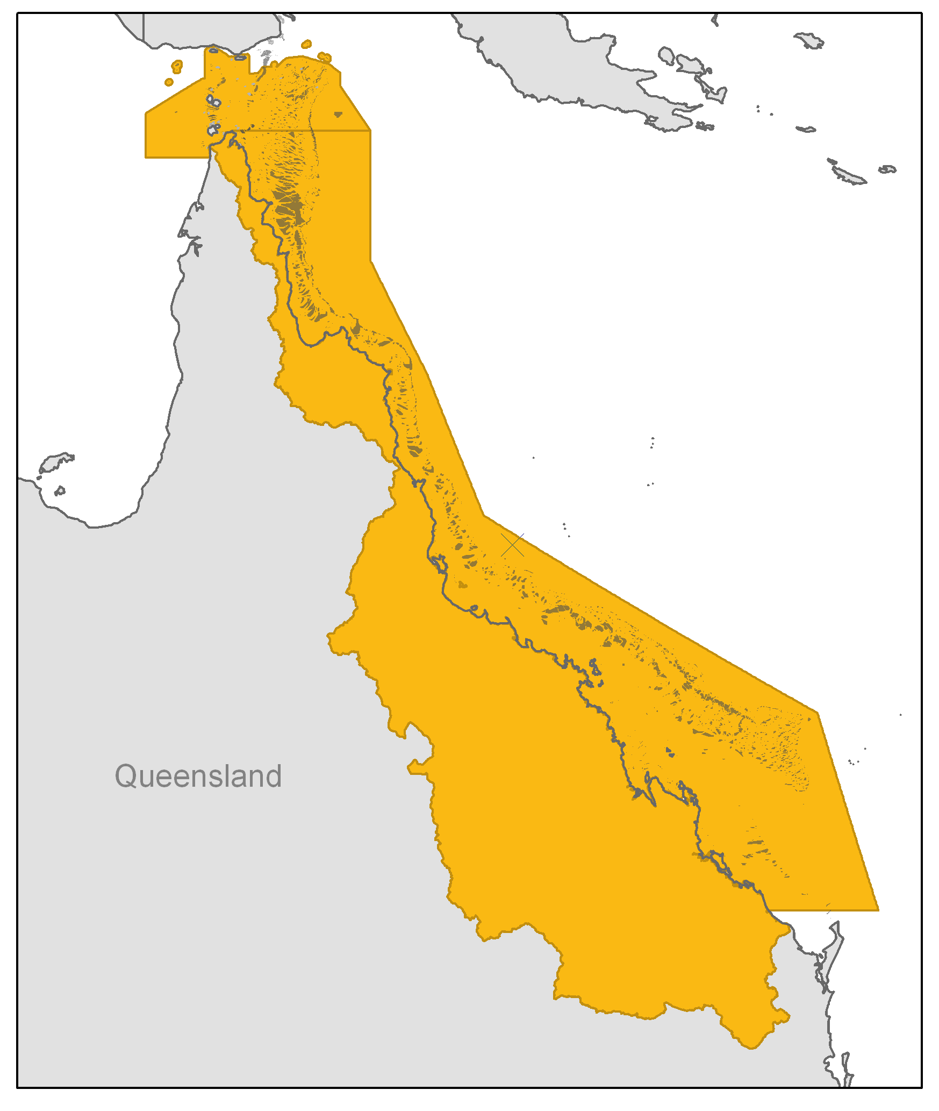
What can you do with the e-Atlas?
Primary regional focus is the Great Barrier Reef, Torres Strait and the Queensland coast.
Search and discover datasets and projects
Evaluate spatial datasets (fit for purpose)
Investigate datasets and their relationships
Share and communicate what you have found

Slide 7








e-Atlas Role
Work with 44 research projects (NERP TE and RRMMP) to capture and visualize their data.
Work with WTMA, GBRMPA, TSRA.
Develop reference base layers and integrate data from external sources.
Over 2200 map layers from 16 institutions.
Feed into national portals
Funded previously by MTSRF and now NERP TE.
RDA
AODN

Slide 8
Demonstration

Slide 9
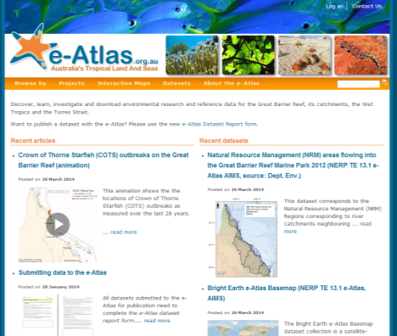
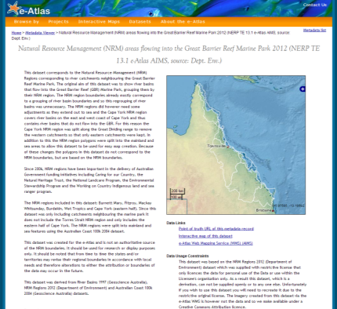
e-Atlas website and metadata system
Contain project information, articles and detailed metadata

Slide 10


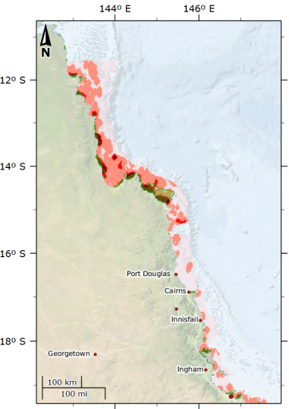
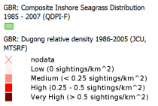
Relationship between Dugongs (JCU) and Seagrass (QDPI)
High dugong areas match closely areas of inshore seagrass meadows
Combining data to two institutions
View as interactive map
Images: Seagrass, CSIRO; Dugong, CC-BY Patrick Quinn-Graham

Slide 11

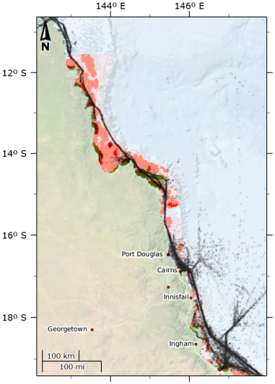
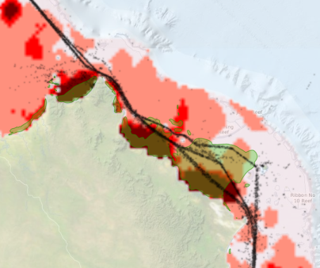
Shipping – Vessel tracking (AMSA)
Shipping is constrained near Lizard Island
Ships travel over seagrass and dugong areas
View as interactive map

Slide 12
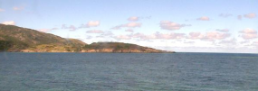
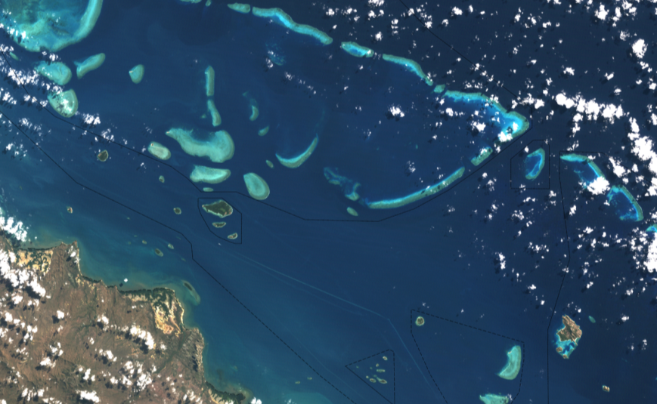
What can we see from Landsat (NASA)?
View as interactive map
14th August 2011
Image: Lizard Island Camera, AIMS, 2013-0402-151035

Slide 13
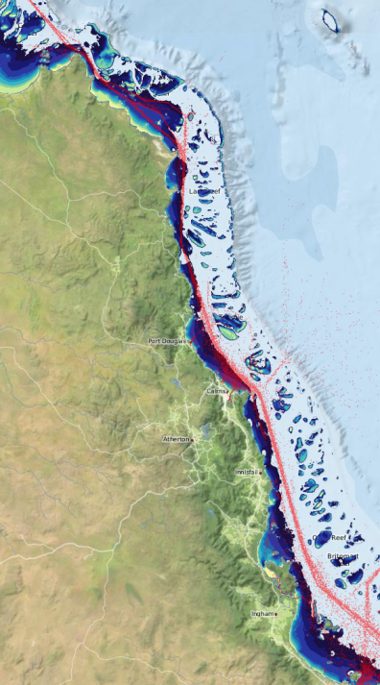
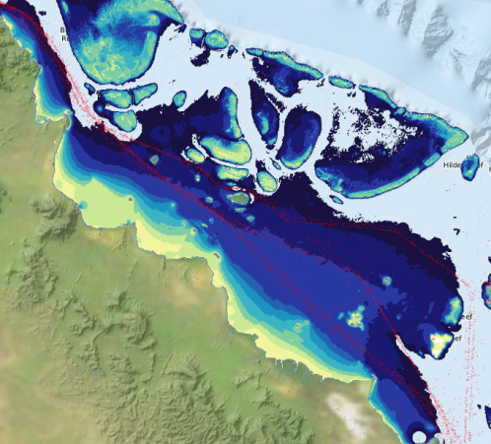
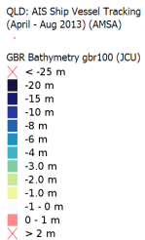
Bathymetry
One of the few shallow regions along the shipping channels
View as interactive map

Slide 14
Design and Architecture

Slide 15
Design Philosophy
Open data / open source software
Follow national / international standards
Use off-the-shelf software where possible
Use custom software for integration and presentation of content to allow tailoring to stakeholder needs
Provide a curated service to reduce burden on researchers

Slide 16









Content Preparation
Systems
System Development
Stories
Map Layers
Data Catalogue
Data
Data documentation
Content
GA
GBRMPA
Collaborate
Prepare data
Data processing Tools
Data, text, images
Data Providers
Content preparation

Slide 17
e-Atlas Systems Overview
Content
Management
Metadata
Mapping
Repository
Enduring Repository
Web site
Meta-data
Viewer
Web mapping viewer
Setup
AIMS meta-data viewer
AtlasMapper
File system
Drupal
Meta-data
Database Server
Mapping server
Off-the-self software
Custom software
ANZ-MEST
GeoNetworks
GeoServer, ncWMS, PostGIS
Custom scripts
Desktop GIS
Photo Metadata
Animation Generation
Project Metadata
Data loading
ArcMap, GDAL
Image Metadata editor
Animated GIF to HTML5
Spreadsheet to ISO19115
GeoServer Bulk-loader
Tools

Slide 18
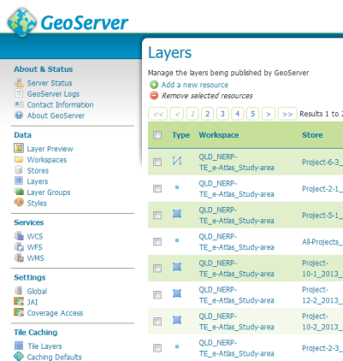
GeoServer
Provides map generation services for the e-Atlas.
  OGC standards – Follow national standards (NEII)
  Spatial data is converted to shapefiles, GeoTiff rasters or PostGIS database
  Styled using Styled Layer Descriptor (SLD) XML files
  Converts data into images via the Web Mapping Service (WMS) standard.
Integrated tile cache (GeoWebCache) – 90% of tile requests are served from the cache.
Allows animation of time based data
Currently serve over 1200 layers

Slide 19
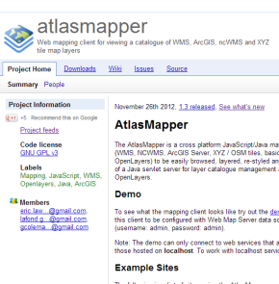
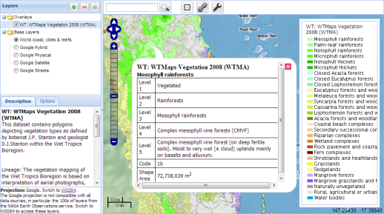
AtlasMapper
Custom Java servlet / Javascript (GeoTools, ExtJS, GeoExt, Openlayers) web based mapping application
Open source hosted on Google Code (https://code.google.com/p/atlasmapper/)
Integrates spatial map services from capabilities documents
Integrate complementary external mapping services
Supports WMS, NCWMS, ArcGIS Server, XYZ / OSM tiles, basic KML.

Slide 20

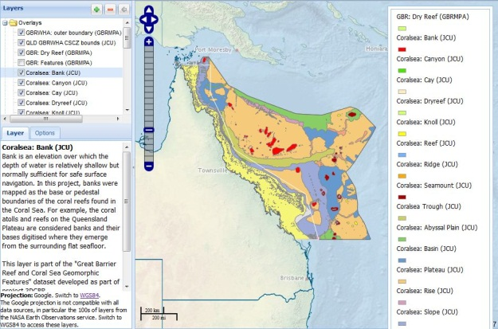
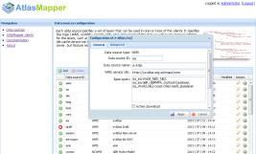
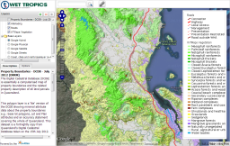
AtlasMapper – Integration of Map Services
Tailored Portals
Region / Topic
AtlasMapper
(e-Atlas product)
Linked Metadata
ISO19115
Google Earth
Basic KMLs
(Point data)
NcWMS
(Model data)
GeoServer
(GIS data)
ArcGIS Server
XYZ tiles
(Basemaps)
Other misc. data
e-Atlas (hydro-graphic modelling)
eReefs (in future)
e-Atlas
IMOS
CSIRO
ALA
AIMS
ArcGIS Online
GBRMPA servers
GA
OpenStreetMap
Stamen Design
Google Earth Engine

Slide 21
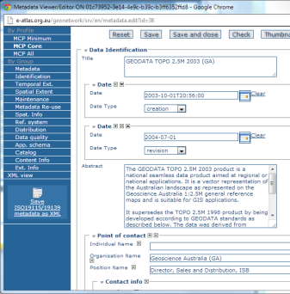
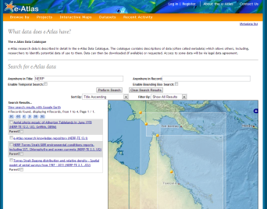
e-Atlas Metadata System
Use:
  ANZ-MEST GeoNetwork
  ISO19115 MCP
Export our records to Research Data Australia
Records are linked from map layers in GeoServer
Use custom MetadataViewer to present records and provide spatial search

Slide 22
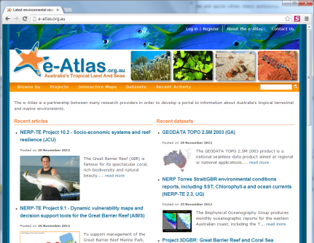
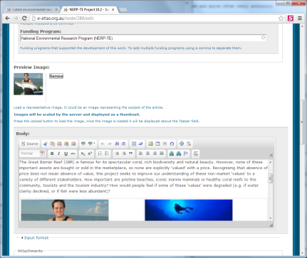
e-Atlas Content Management System
Manages:
  Articles
  Project pages
  Photo gallery
  Blog
  RSS feeds
  General Search
Based on Drupal 6, redeveloping in Drupal 7

Slide 23
Bulk loader tool
Automatically detect GIS files
Configure layers using spreadsheet
Upload to GeoServer using REST API
Useful for datasets with 10’s to 100’s layers
Written in R-script
Available as part of the e-Atlas data tools

Slide 24
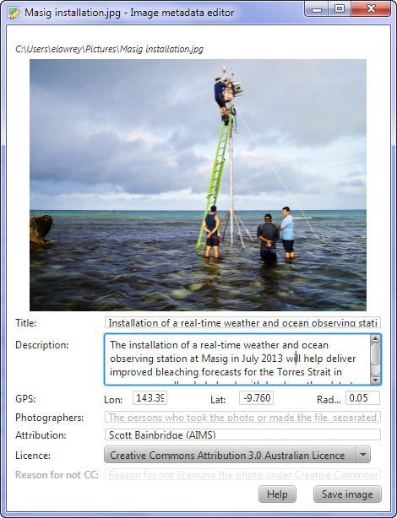
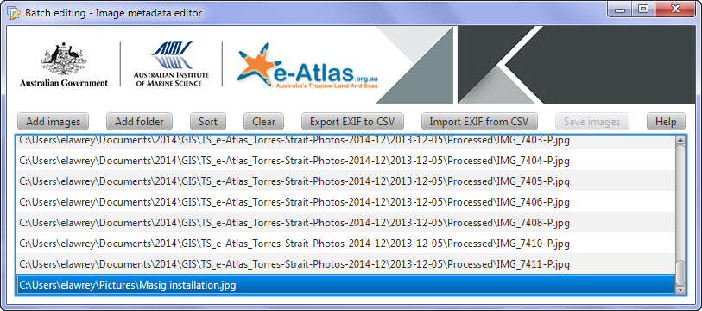
Image Metadata editor
Java application
View and edit metadata, saved in image EXIF
Bulk edit with CSV export and import
Website automatically extracts metadata and links to profiles
Available as part of the e-Atlas data tools

Slide 25
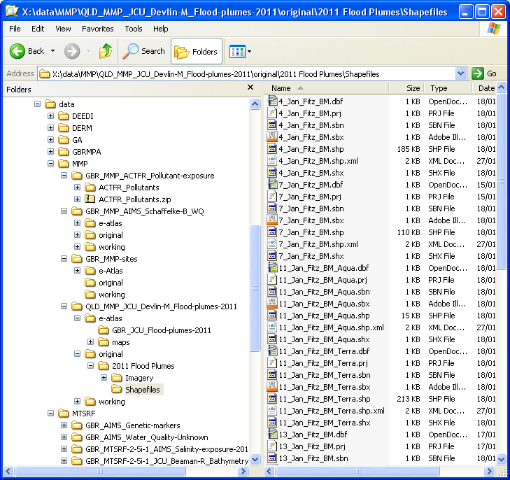
e-Atlas Enduring Repository
Houses research products and raw data (GIS files, spread sheets, documents, databases, images, etc.)
Intended to ensure data is useable in 20+ years
Multi-site backup and disaster recovery system
Simple file repository
Convention based curation

Slide 26
Importance of data and data management
Working with Researchers

Slide 27


Data sharing isn’t easy
Research community culture is slow to embrace open data sharing
© Hanson K., Surkis A., Yacobucci K.
https://www.youtube.com/watch?v=N2zK3sAtr-4

Slide 28
Barriers to sharing of data
Sharing of data is typically a low priority and an after thought.
Barriers to sharing research data:
  competitive research environment
  careers based on a dataset
  pressure to publish
  poor data documentation
  lack of licensing awareness
  fear of misuse of data
Limited data sharing slows our ability to capture research and make it useful for management.

Slide 29
Lessons learned – MTSRF Program (2008 – 2010)
No clear program guidelines for data or metadata
No project milestones to submit content
Simplified online metadata forms via e-Atlas website
Fail for data management: Researchers didn’t engage; only a fraction of projects submitted content, much with poor documentation. No staff dedicated to working with researchers.
Culture very protective of data
  only 5-10% projects happy to make data open.

Slide 30

Lessons learned - NERP TE (2011 – 2014)
Program principals of public delivery of content under an open license – force change
  Not clear at the outset of the program – caught researchers by surprise.
  No funds for open publications – most papers are paywalled.
Regular group meetings (every 6 months) between project leaders and researcher users – Allowed e-Atlas to:
  Re-enforce principals of open data
  Learn and engage with projects
Culture is now much more open with data
  70 - 80% happy to make data open (eventually but perhaps not raw data)
  Must be considerate of journal publication restrictions
  Still need much coaxing to get documented data
Milestones to deliver data products helps
Most of the data comes at the end of the program – Not good for the e-Atlas

Slide 31
Future – Next 9 months
New website
  Support regional / topic targeted atlases
Launch Torres Strait e-Atlas
  Complete mapping of Torres Strait reefs and islands
Prepare and integrate NERP TE results

Slide 32





Thank you
CONTACT
Name: Eric Lawrey
Organisation: Australian Institute of Marine Science
Phone: 4753 4116
Email: e.lawrey@aims.gov.au
The content of this presentation is made available under a Creative Commons Attribution 3.0 Australia license, except for the AIMS, CSIRO NERP logos and the NERP branding. These trademarks are used with permission from their respective owners.
© Eric Lawrey, e-Atlas, AIMS, NERP TE, 2014, http://e-atlas.org.au/presentations/2014-04-e-atlas-technical-overview

