Slide 1



eAtlas – Technical Overview
Data management and visualization for environmental research data
Eric Lawrey
May 2015

Slide 2

The eAtlas Development Team
Dr Eric Lawrey
  Worked on the eAtlas since 2008.
  System developer from 2008 - 2010.
  Now eAtlas project leader
  Focus on:
    Data preparation, GIS dataset creation
    Stakeholder and researcher engagement
    System design
B.E (Computer Systems), PhD. (modelling wireless communications)

Slide 3

The eAtlas Development Team
Gael Lafond
  Worked on the eAtlas since 2010.
  System programer, server administration
  Applications:
    Drupal CMS (website)
    AtlasMapper (eAtlas mapping client)
    Image Metadata Editor
  Baccalaureate in computer science (University of Montreal, Canada)

Slide 4
Agenda
What is the eAtlas?
Demonstration
Design and architecture
Importance of data and data management

Slide 5
What is the eAtlas?

Slide 6
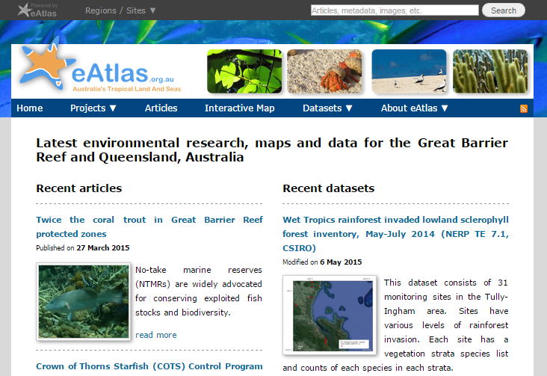
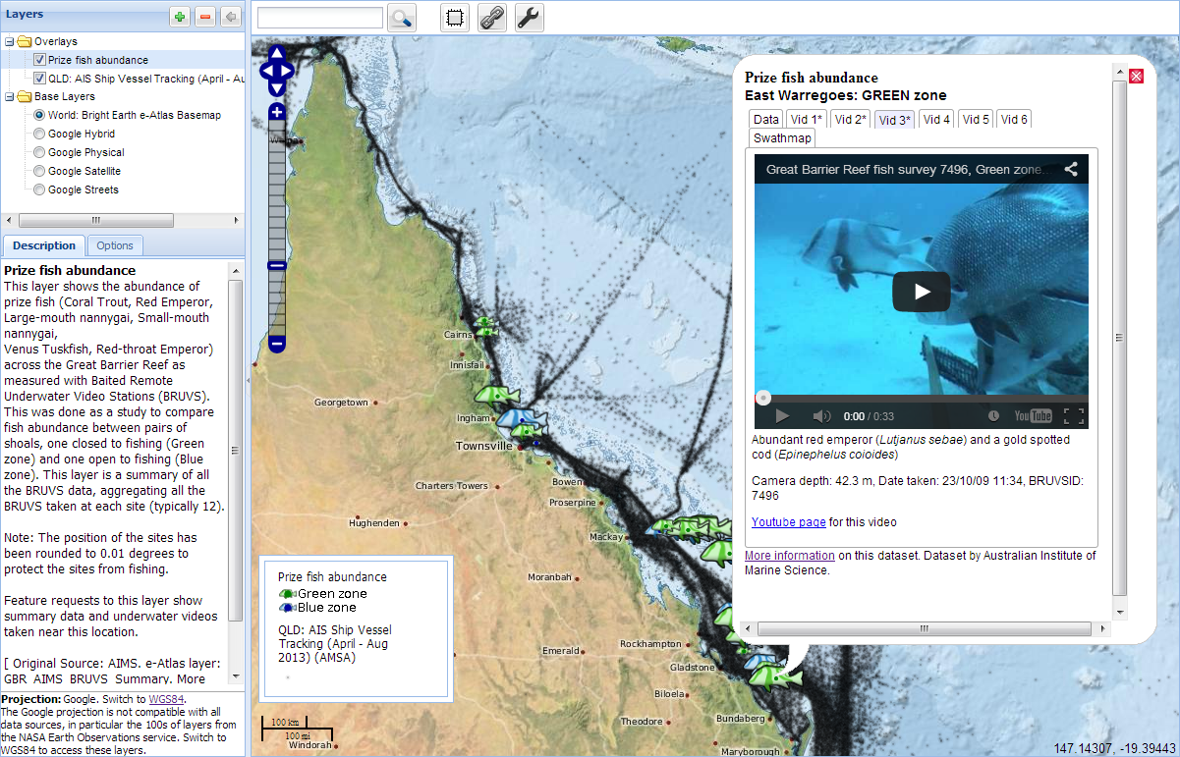
What is the eAtlas?
Website and mapping system for making environmental research available online.
Intended to improve access and use of science.
  Researchers, Managers, Public
Maps, data, meta-data, visualization tools, articles, projects, people.

Slide 7


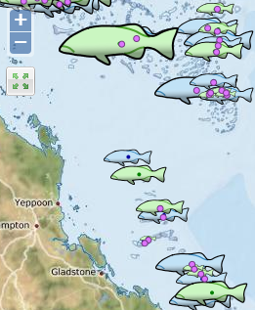

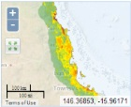
Improving access to research data
Normal Research workflow
Data
collection
Raw data
Analysis
Prepared dataset
Technical Reports, Papers
eAtlas public delivery
Data documentation (metadata)
Data Access (dowloadable data)
Visualisation
(spatial data)
Articles, project information, photos

Slide 8
Regional Atlases
Torres Strait eAtlas
North West Atlas
Ningaloo Atlas
GBR & Wet Tropics eAtlas

Slide 9
What can you do with the eAtlas?
Search and discover datasets and projects
Evaluate spatial datasets (fit for purpose)
Investigate datasets and their relationships
Share and communicate what you have found

Slide 10








eAtlas Role
Work with research projects to capture and visualize their data.
Work with WTMA, GBRMPA, TSRA.
Develop and maintain eAtlas technology.
Develop reference base layers and integrate data from external sources.
Over 3500 map layers from 16 institutions.
Feed into national portals
RDA
AODN

Slide 11
Demonstration

Slide 12
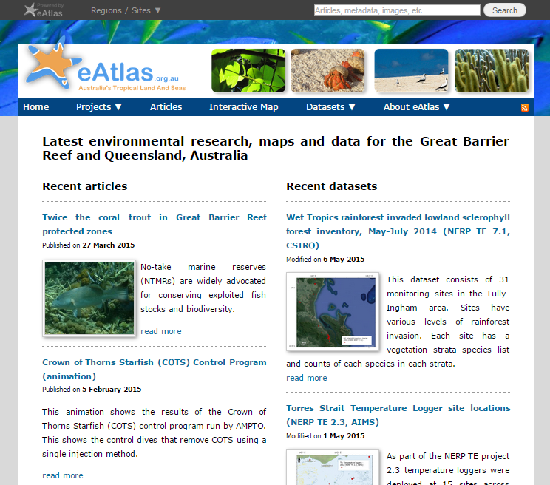
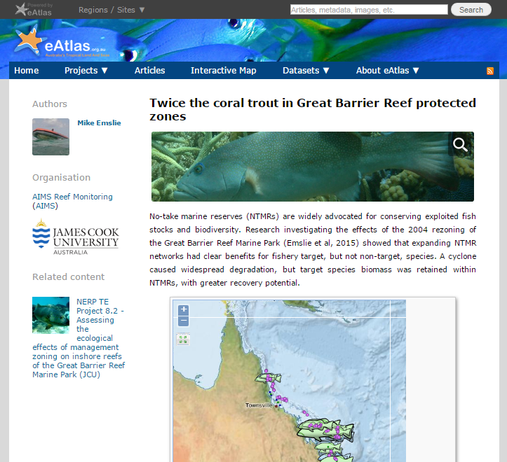
eAtlas website and metadata system
Contains project information, articles, photos and detailed metadata
Built using Drupal 7
Notes:
These slides are to indicate what to cover in the demonstration.

Slide 13
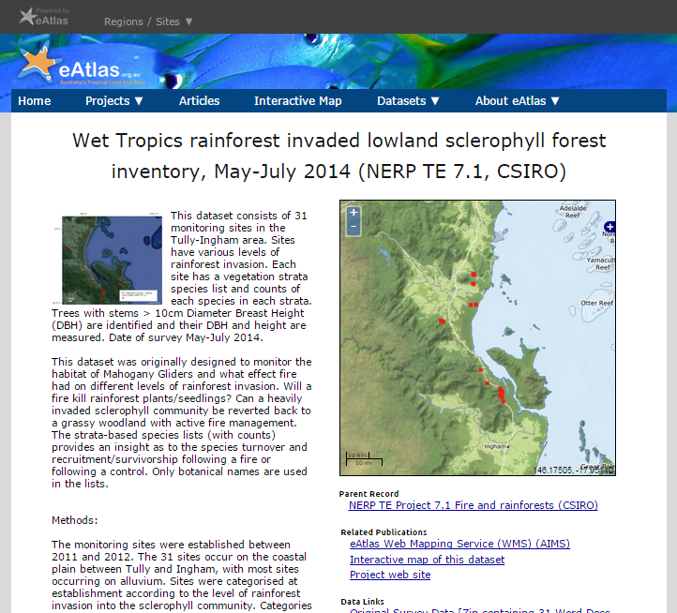
eAtlas metadata system
Contains detailed metadata
GeoNetwork (backend), version 2.10
MetadataViewer (frontend), custom software
Notes:
These slides are to indicate what to cover in the demonstration.

Slide 14


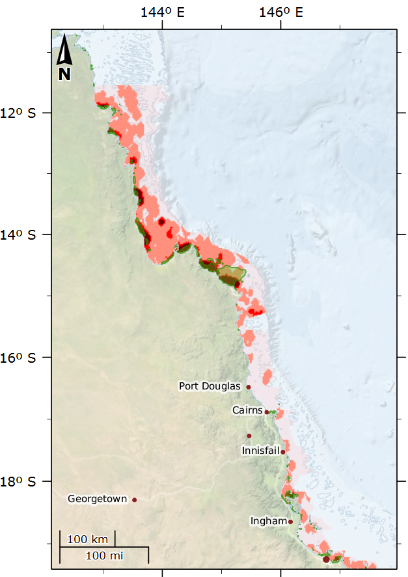
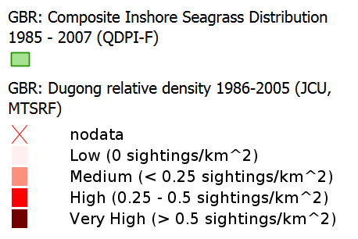
Relationship between Dugongs (JCU) and Seagrass (QDPI)
High dugong areas match closely areas of inshore seagrass meadows
Combining data to two institutions
View as interactive map
Images: Seagrass, CSIRO; Dugong, CC-BY Patrick Quinn-Graham

Slide 15

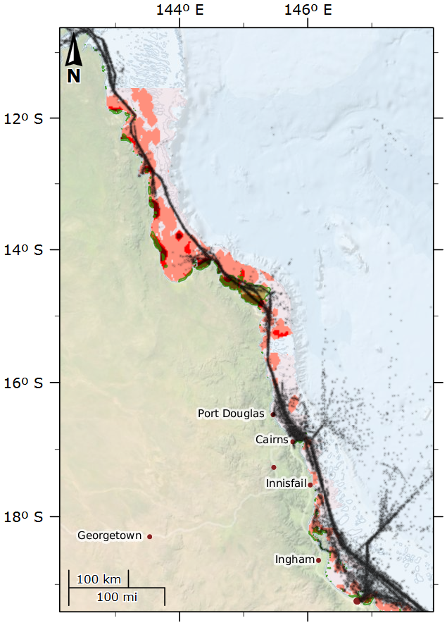
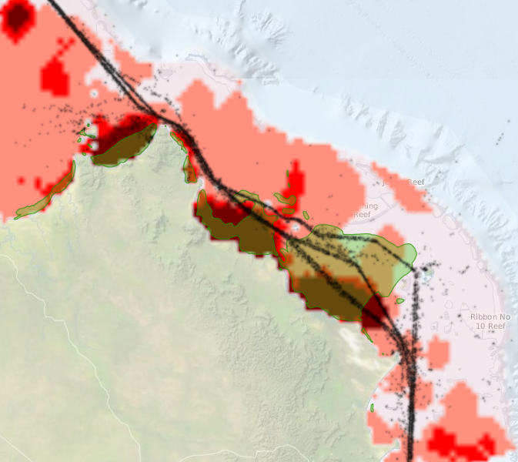
Shipping – Vessel tracking (AMSA)
Shipping is constrained near Lizard Island
Ships travel over seagrass and dugong areas
View as interactive map

Slide 16
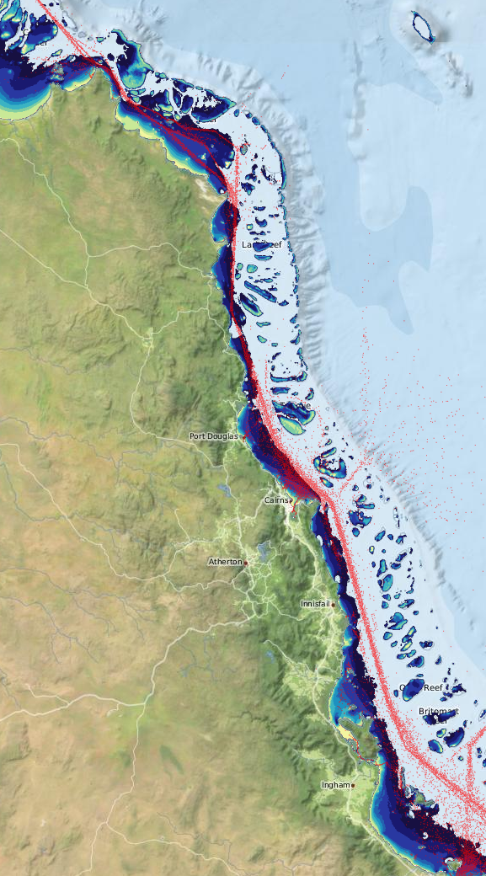
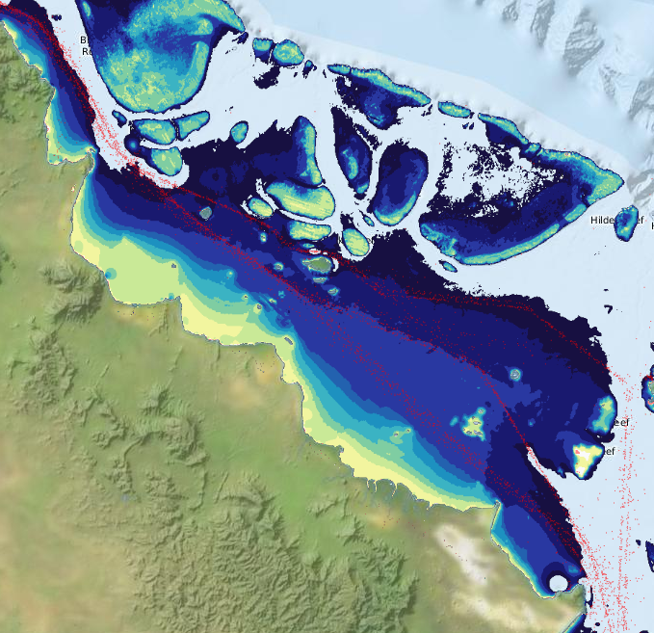
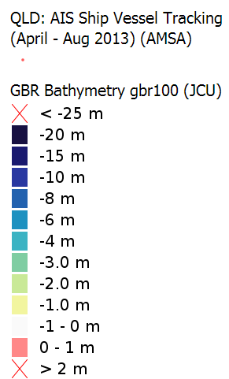
Bathymetry
One of the few shallow regions along the shipping channels
View as interactive map

Slide 17
Design and Architecture

Slide 18
Design Philosophy
Open data / open source software
Follow national / international standards
Use off-the-shelf software where possible
Use custom software for integration and presentation of content to allow tailoring to stakeholder needs
Provide a curated service to reduce burden on researchers

Slide 19


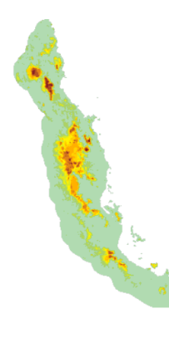
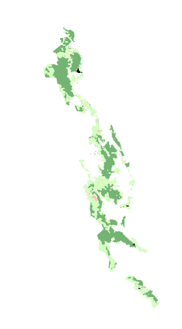
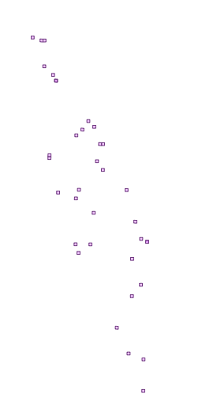







Content Preparation
Systems
System Development
Stories
Map Layers
Data Catalogue
Data
Data documentation
Content
GA
GBRMPA
Collaborate
Prepare data
Data processing Tools
Data, text, images
Data Providers
Content preparation

Slide 20
eAtlas Systems Overview
Private Repository
Public Repository
Content
Management
Metadata
Mapping
Enduring Repository
File sharing
Web site
Meta-data
Viewer
Web mapping viewer
Setup
AIMS meta-data viewer
AtlasMapper
File system
Pydio
Drupal
Linked public data
Meta-data
Database Server
Mapping server
Off-the-self software
Editor upload
GeoServer, ncWMS, PostGIS
Custom software
GeoNetwork
Custom scripts
Desktop GIS
Photo Metadata
Animation Generation
Project Metadata
Data loading
ArcMap, GDAL
Image Metadata editor
Animated GIF to HTML5
Spreadsheet to ISO19115
GeoServer Bulk-loader
Tools

Slide 21
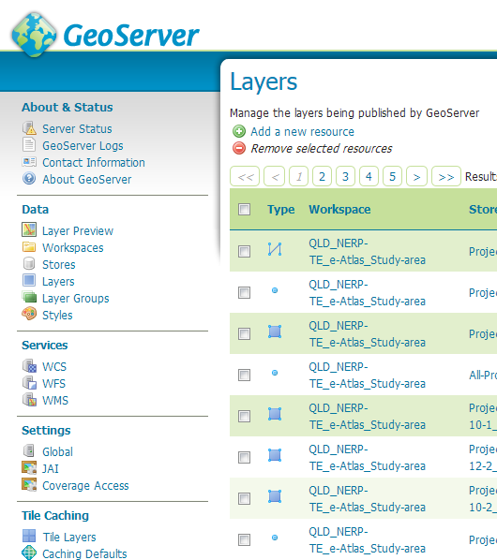
GeoServer
Provides map generation services for the eAtlas.
  OGC standards – Follow national standards (NEII)
  Spatial data is converted to shapefiles, GeoTiff rasters or PostGIS database
  Styled using Styled Layer Descriptor (SLD) XML files
  Converts data into images via the Web Mapping Service (WMS) standard.
Integrated tile cache (GeoWebCache) – 90% of tile requests are served from the cache.
Allows animation of time based data
Currently serve over 1300 layers.
Use version 2.6, uncustomised

Slide 22
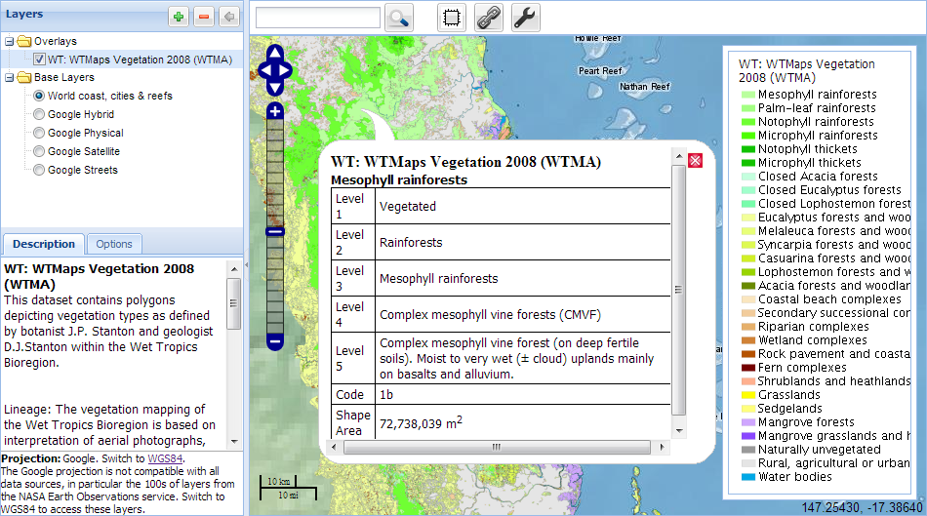
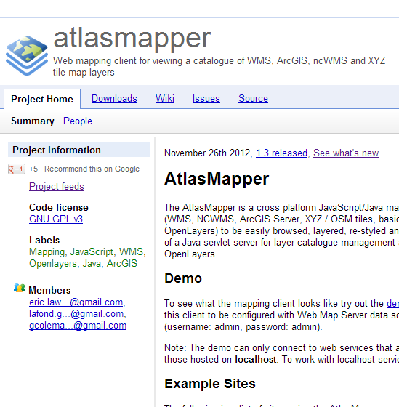
AtlasMapper
Custom Java servlet / Javascript (GeoTools, ExtJS, GeoExt, Openlayers) web based mapping application
Open source hosted on Google Code (https://code.google.com/p/atlasmapper/)
Note: this site will moved to GitHub in the future
Integrates spatial map services from capabilities documents
Integrate complementary external mapping services
Supports WMS, NCWMS, ArcGIS Server, XYZ / OSM tiles, basic KML.
Harvests service capabilities documents to configure all the layers.

Slide 23

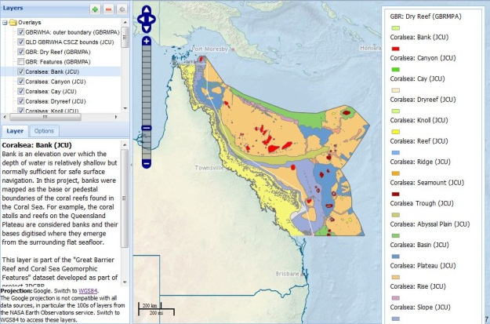
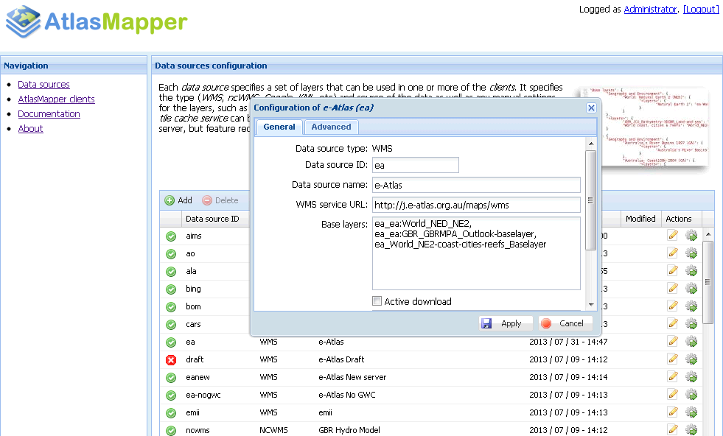
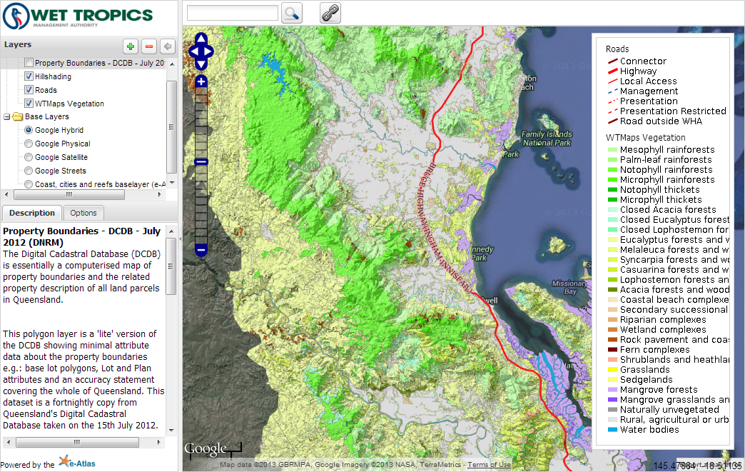
AtlasMapper – Integration of Map Services
Tailored Portals
Region / Topic
AtlasMapper
(eAtlas product)
Linked Metadata
ISO19115
Google Earth
Basic KMLs
(Point data)
NcWMS
(Model data)
GeoServer
(GIS data)
ArcGIS Server
XYZ tiles
(Basemaps)
Other misc. data
eAtlas (hydro modelling)
eReefs (in future)
eAtlas
IMOS
CSIRO
ALA
AIMS
ArcGIS Online
GBRMPA servers
GA
OpenStreetMap
Stamen Design
Google
Bing

Slide 24
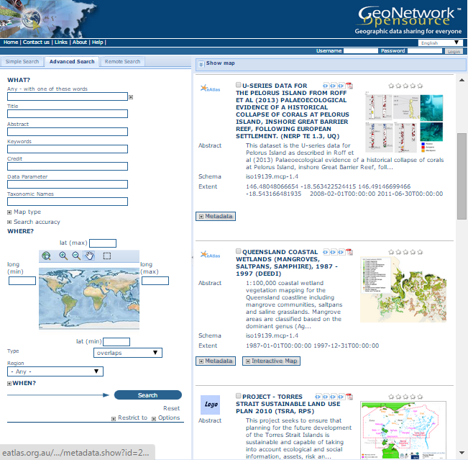
eAtlas Metadata System
Use:
  ANZ-MEST GeoNetwork 2.10
  ISO19115 MCP metadata standard
Export our records to Research Data Australia. (They convert them to Rif-CS standard)
Records are linked from map layers in GeoServer.
Use custom MetadataViewer to present records and provide spatial search.

Slide 25
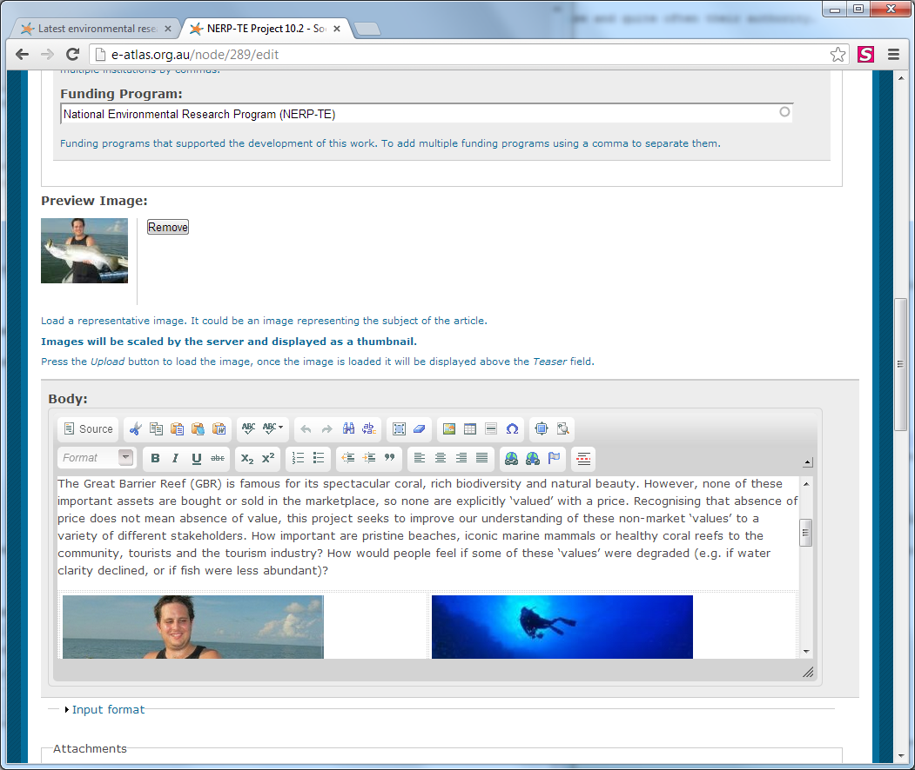
eAtlas Content Management System
Manages:
  Articles
  Project pages
  People / Projects
  Photos/Galleries
  RSS feeds
  Integrated Search (website and metadata)
Based on Drupal 7

Slide 26


Shared Conent – Multi-site branding
Articles, map layers and images can be shared across all eAtlas sites
Each site has custom:
  Branding
  Front page
  Main navigation menu
  Mapping portal
Each site can be maintained by different institution
Share common CMS, GeoNetwork, MetadataViewer.
Custom module in Drupal 7 allows the editors to tag which site/s each piece of content is available in.
North West
Atlas
Main
eAtlas
Shared content
Shared
Content
Torres Strait eAtlas
Other eAtlas
Websites
SELTMP

Slide 27
CMS – Integrated Search
Core modules include:
Views – Create sets of content of a particular type (article lists
Media Gallery – Manage photos (needed lots of bug fixes)
Number of custom modules – Apply bug fixes, metadata harvesting, integrated search, multi-site branding.

Slide 28
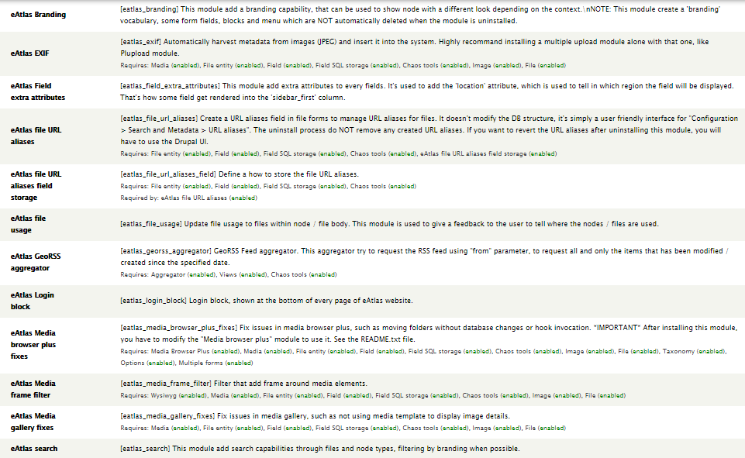
Custom Drupal 7 modules

Slide 29


Integrated Search – Website & Metadata
Both website and metadata are integrated into a single search.
Summary metadata is harvested into the website using RSS feed.
Search results link directly to metadata page, not node in website.
Article Page
Search Page
Metadata Page
Metadata summary
Only visible as link in search results
Public View
Backend View
Metadata Record summary
RSS feed
Integrated Search
Meta-data
Viewer
Convert to Drupal nodes
Website
Metadata Records
XML services and DB access
GeoNetwork
Articles, Projects, People, Photos, etc.
Metadata Record summary

Slide 30
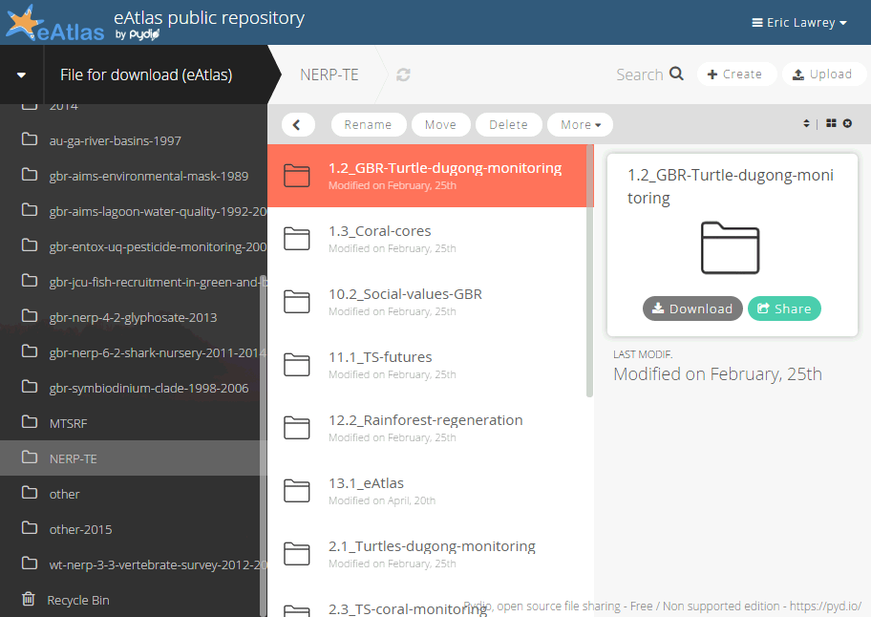
Pydio – Getting files on the server
Pydio – Web based file sharing application
Use it to make it easy for editors to upload to server.
Workspaces for:
  Files for download
  GIS data for GeoServer

Slide 31
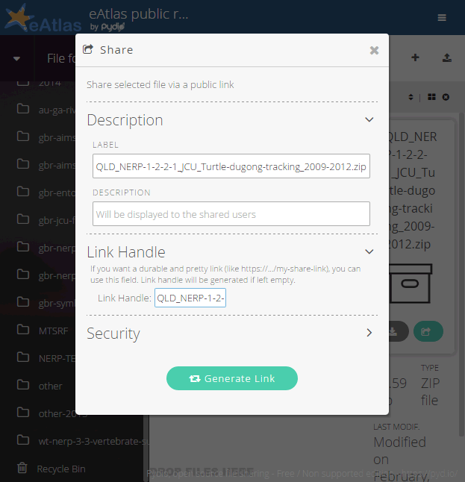
Pydio – Files for download
Includes all content linked from metadata including:
  PDFs
  Zipped Data
Use built in sharing to make files publicly accessible.
Allocate Link Handles matching file name to allow creating of maintainable URLs.

Slide 32
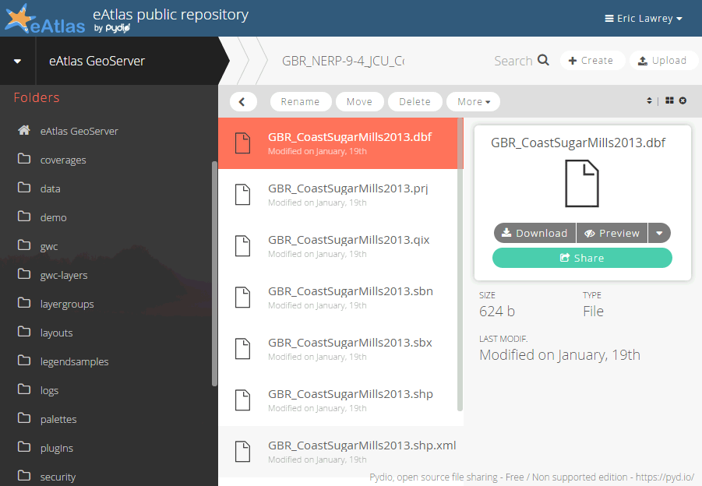
Pydio – Accessing GeoServer
Directly access GeoServer configuration directory.
Can upload to data, styles and workspaces (GeoServer), other directories are read-only.

Slide 33
Bulk loader tool
Used for uploading lots of layers (10’s to 100’s) to GeoServer.
Configure details of the layers in spreadsheet. Allows formulas and easy copy and paste.
Automatically detect GIS files (Shapefiles, GeoTiff)
Upload to GeoServer using REST API
Written in R-script
New version being developed in Java with a GUI.
Available as part of the eAtlas data tools

Slide 34
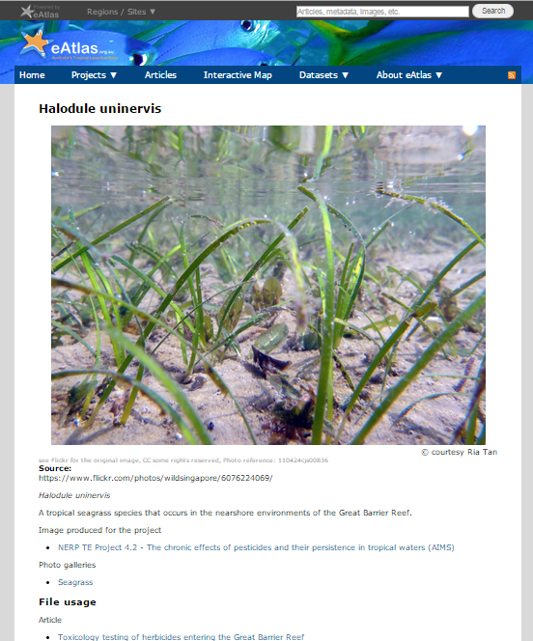
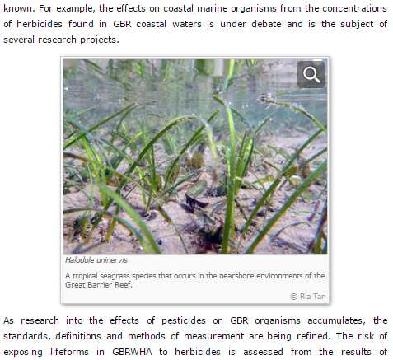
Photo management
Record detailed metadata for photos.
Attribution, licensing, description, useage in site.
Each photos has its own page.

Slide 35
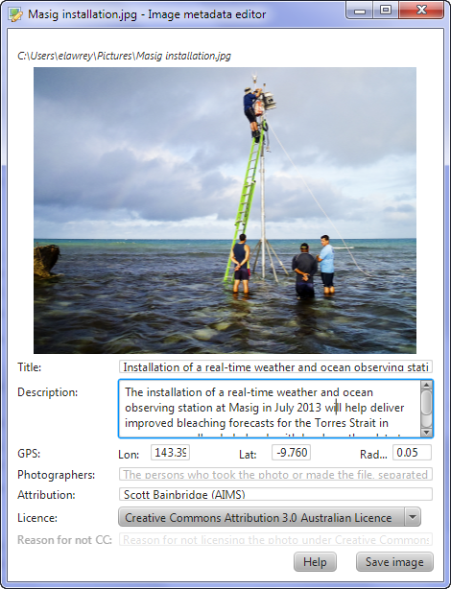
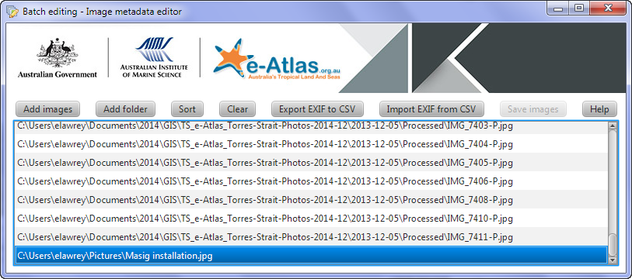
Image Metadata editor
Java application
View and edit metadata, saved in image EXIF
Bulk edit with CSV export and import
Website automatically extracts metadata and links to profiles
Available as part of the eAtlas data tools
Download and documentation:
http://eatlas.org.au/tools/image-metadata-editor

Slide 36
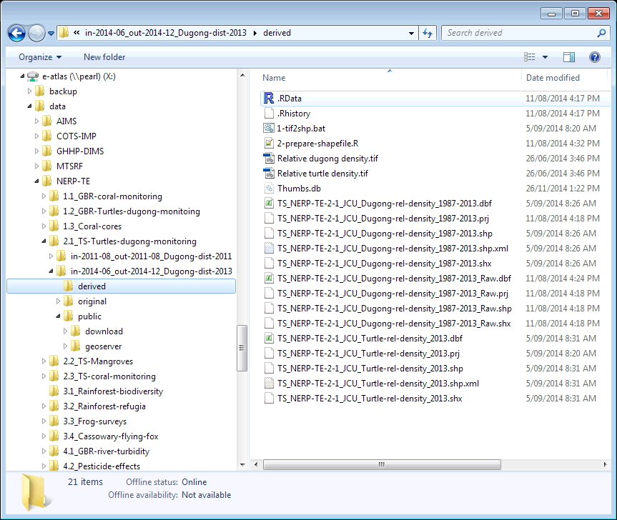
eAtlas Enduring Repository
Houses research products and raw data (GIS files, spread sheets, documents, databases, images, etc.)
Intended to ensure data is useable in 20+ years without eAtlas servers
Multi-site backup and disaster recovery system
Simple file repository
Convention based curation
Not web accessible

Slide 37
Enduring Data Repository
Top level organised by major data providers:
  Partner organisations
    Content organised by datasets
  Research programs
    Content organised by project folders, then submissions (approximately datasets)
Dataset folders have subfolders to organise workflow:
  Original – original files and emails from data provider
  Derived – any alterations to the original files such as format conversions, text corrections, processing.
  Public – Files that are hosted publicly on eAtlas:
    GeoServer – GIS files for the mapping server
    Download – Files for downloading via the metadata record.
Dataset folders use a naming convention:
  {Region}_{Program and project code}_{Insitution}_{Description}_{Years}
  TS_NERP-TE-2-1_JCU_Turtle-dugong-rel-density_1987-2013
  AU_NNTT_Native-title-determination_2015
Dataset names are used for naming of download zips and WMS layers

Slide 38
Importance of data and data management
Working with Researchers

Slide 39


Remember data sharing isn’t easy
Research community culture is slow to embrace open data sharing
© Hanson K., Surkis A., Yacobucci K.
https://www.youtube.com/watch?v=N2zK3sAtr-4

Slide 40
Barriers to sharing of data
Sharing of data is typically a low priority and an after thought.
Barriers to sharing research data:
  competitive research environment
  careers based on a dataset
  pressure to publish
  poor data documentation
  lack of licensing awareness
  fear of misuse of data
Limited data sharing slows our ability to capture research and make it useful for management.

Slide 41

Thank You
The content of this presentation is made available under a Creative Commons Attribution 3.0 Australia license, except for the AIMS, CSIRO NERP logos and the NERP branding. These trademarks are used with permission from their respective owners.
© Eric Lawrey, eAtlas, AIMS, NERP TE, 2014, http://eatlas.org.au/presentations/2015-05-eAtlas-technical-overview

