Slide 1



eAtlas – Content Editors Introduction
Data management and visualization for environmental research data
Eric Lawrey
Jan 2019

Slide 2
What is the eAtlas?

Slide 3
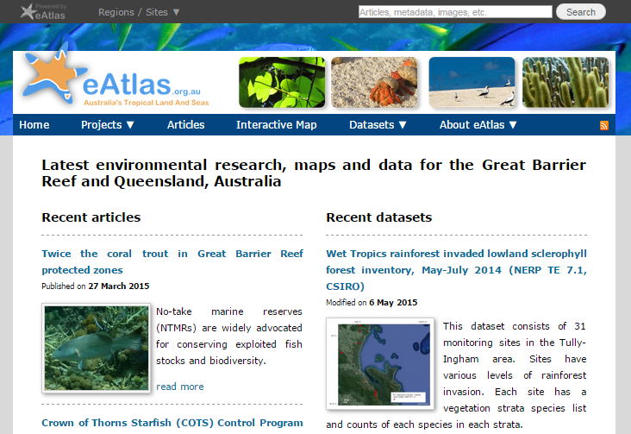
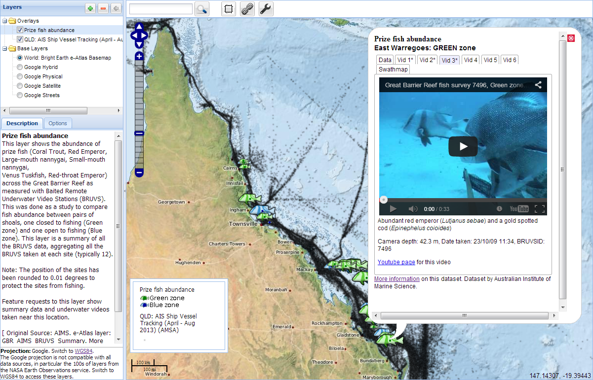
What is the eAtlas?
Website and mapping system for making environmental research available online.
Intended to improve access and use of science.
  Researchers, Managers and Public
Maps, data, meta-data, visualization tools, articles, projects, people.

Slide 4


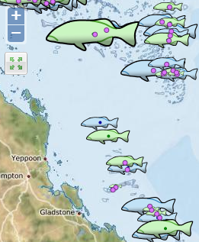

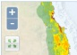
Improving access to research data
Normal Research workflow
Data
collection
Raw data
Analysis
Prepared dataset
Technical Reports, Papers
eAtlas public delivery
Data documentation (metadata)
Data Access (dowloadable data)
Visualisation
(spatial data)
Articles, project information, photos

Slide 5
eAtlas Platform – multiple sites
Torres Strait eAtlas
2013+
NERP, NESP, TSRA
North West Atlas
2015+
PTTEP, NESP
NESP eAtlas
2009 +
MTSRF, NERP, NESP
Ningaloo Atlas
2010 – 2014
BHP
Australian Marine Park Science Atlas
2018+
Parks Australia

Slide 6
What can you do with the eAtlas?
Search and discover datasets and projects
Evaluate spatial datasets (fit for purpose)
Investigate datasets and their relationships
Share and communicate what you have found

Slide 7








eAtlas team role
Maintain and develop eAtlas systems
Provide training for content editors
Work with NESP TWQ research projects to capture and visualize their data.
Work with management agencies.
Over 3500 map layers from 16 institutions.
Feed into national portals
RDA
AODN

Slide 8
Demonstration

Slide 9
Demonstration
Content Management System
  Website front page
  Articles
  People / Organisation / Projects
  Photo pages
  Embedded maps
Map system
  Adding layers
  Pulling out stories from available data
Metadata system
Multiple sites

Slide 10


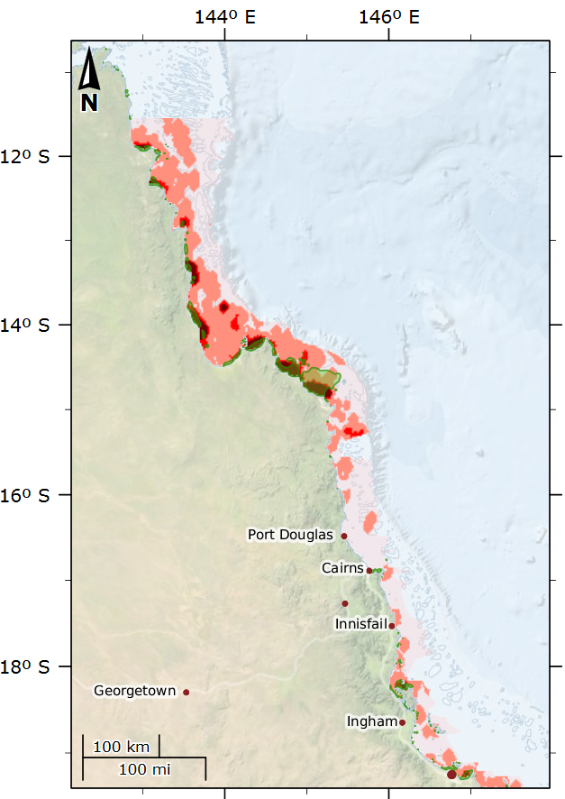
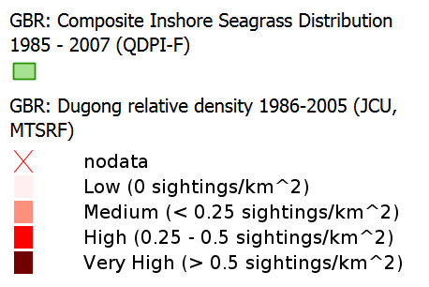
Relationship between Dugongs (JCU) and Seagrass (QDPI)
High dugong areas match closely areas of inshore seagrass meadows
Combining data to two institutions
View as interactive map
Images: Seagrass, CSIRO; Dugong, CC-BY Patrick Quinn-Graham

Slide 11

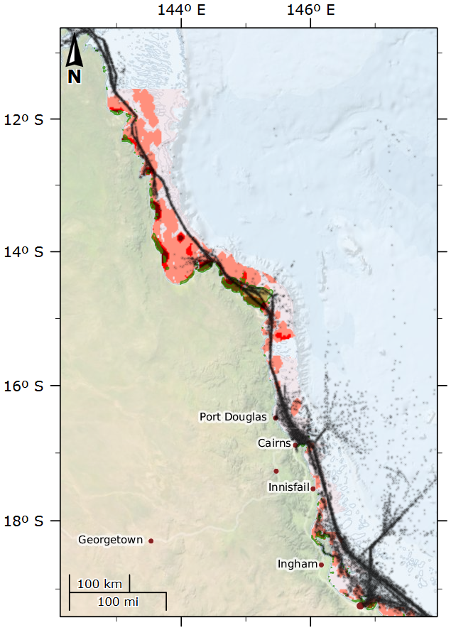
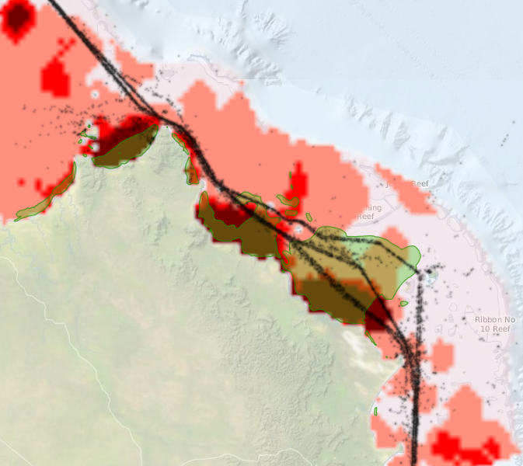
Shipping – Vessel tracking (AMSA)
Shipping is constrained near Lizard Island
Ships travel over seagrass and dugong areas
View as interactive map

Slide 12
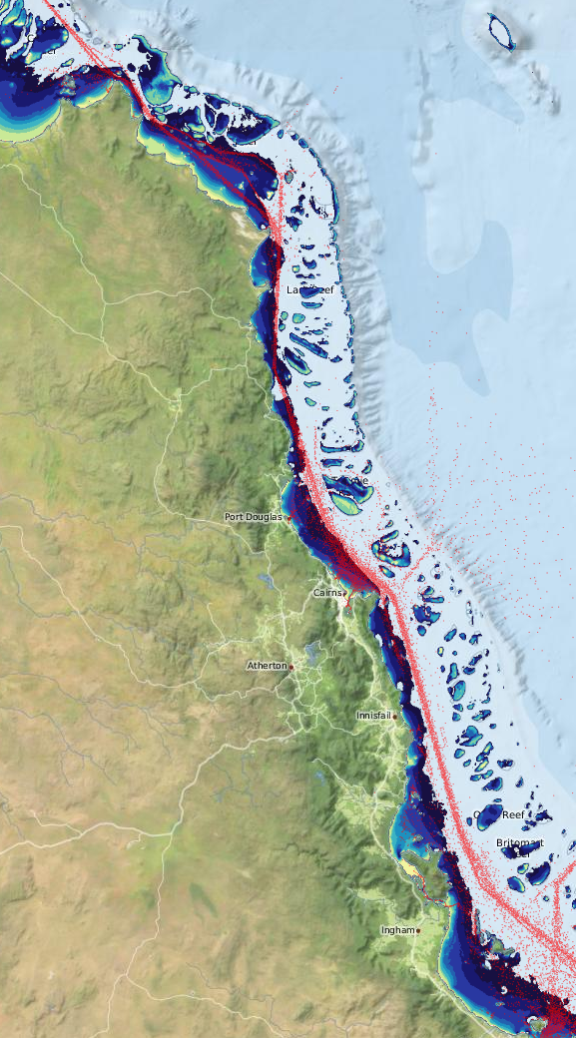
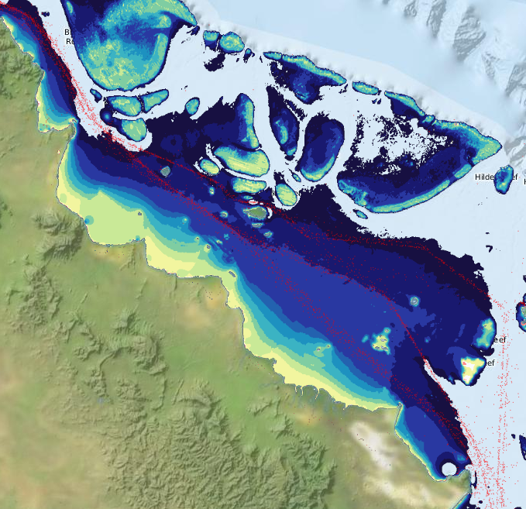
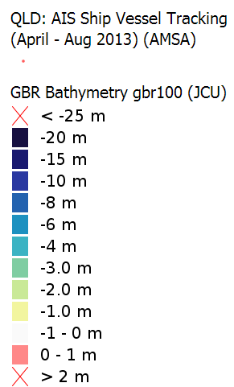
Bathymetry
One of the few shallow regions along the shipping channels
View as interactive map

Slide 13
Elements of stories

Slide 14
Content types
Content Management System
People
Articles
Map Layers
Organisations
Photos
Metadata
Projects
Videos
Navigation and cross linking
YouTube
Core content for telling stories

Slide 15
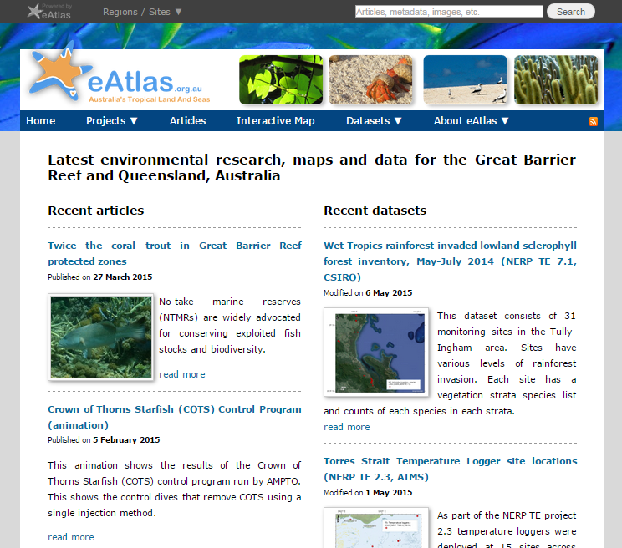
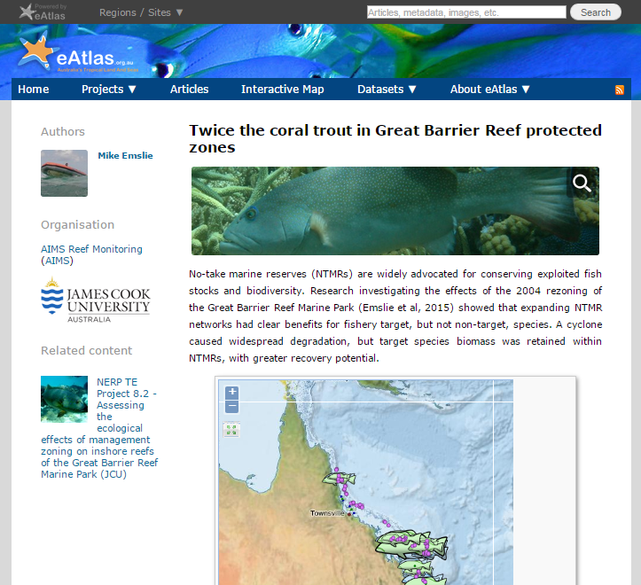
eAtlas website
Contains project information, articles, photos
Built using Drupal 7 Content Management System
Notes:
These slides are to indicate what to cover in the demonstration.

Slide 16
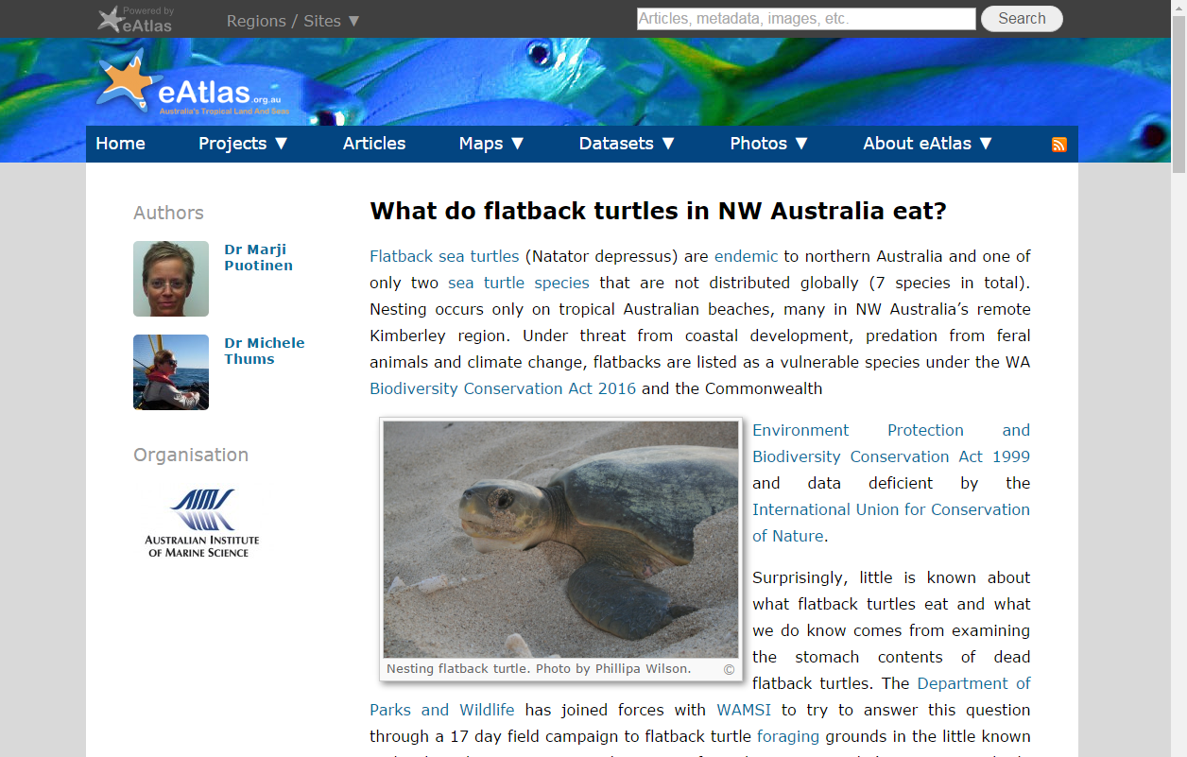
Articles
Engaging title
Free form article text and photos
Attribution for authors (optional)

Slide 17
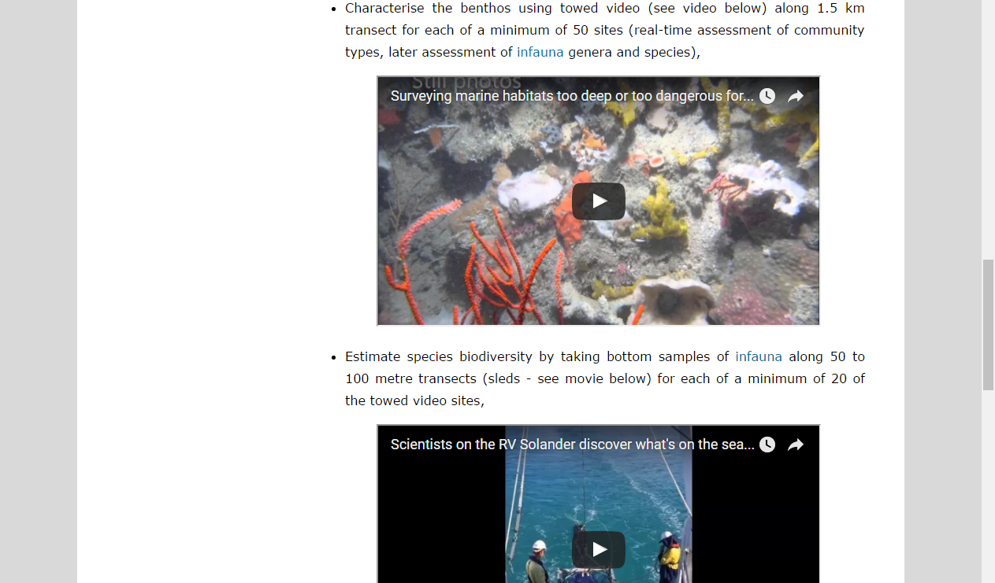
Articles - Embedded videos
Embed videos from YouTube

Slide 18
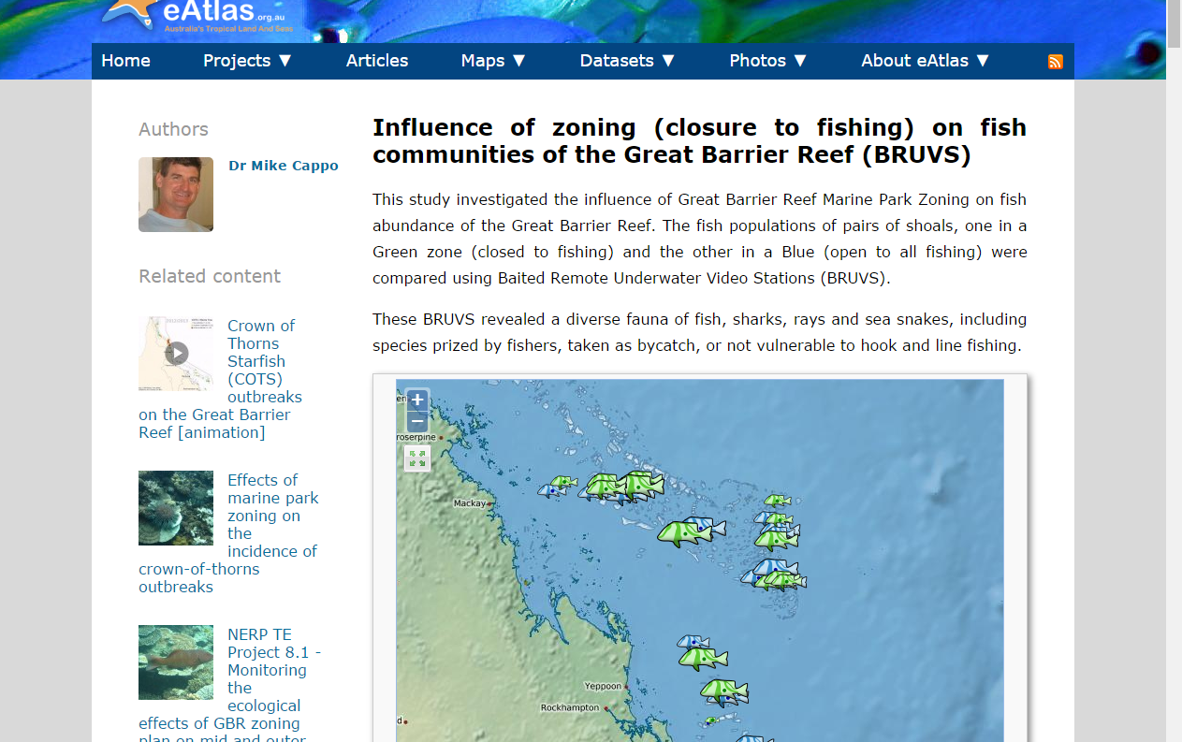
Articles – Embedded maps
Link to other site content
Embed interactive maps

Slide 19
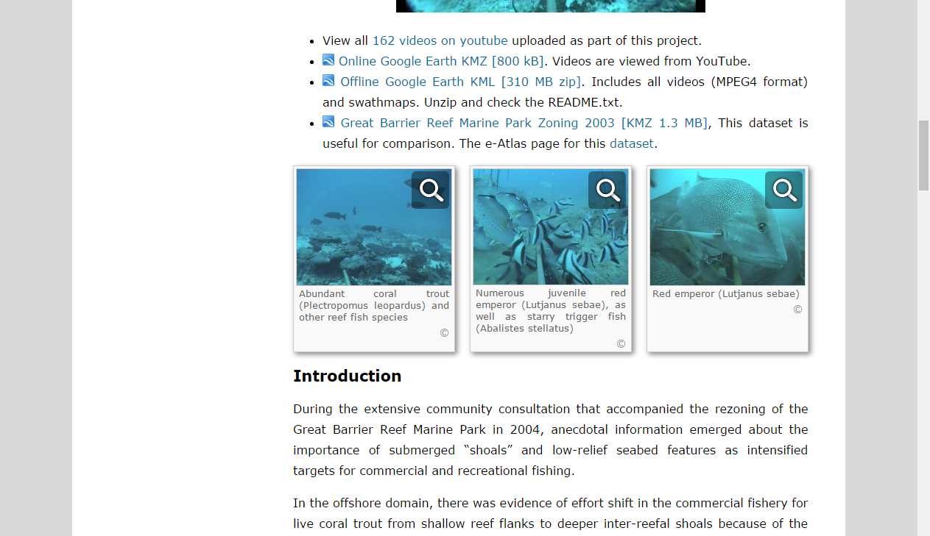
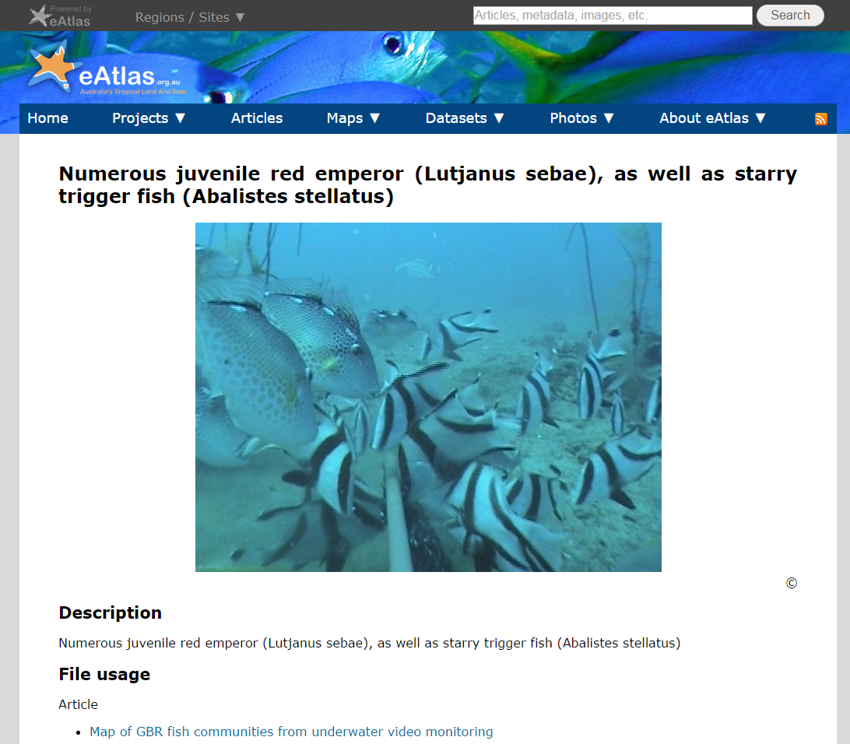
Each photo is a new page

Slide 20
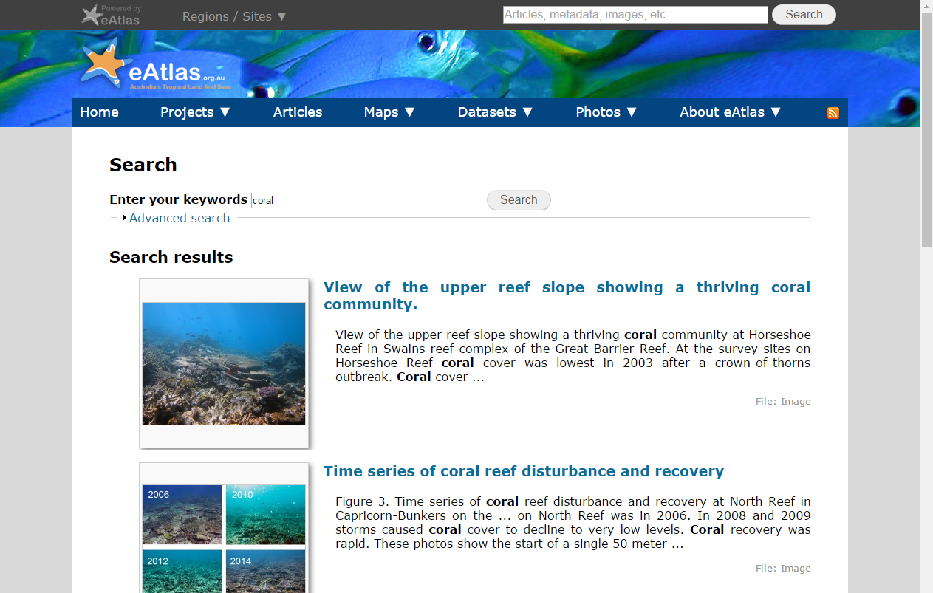
Photos as mini-articles
Metadata from photo page

Slide 21
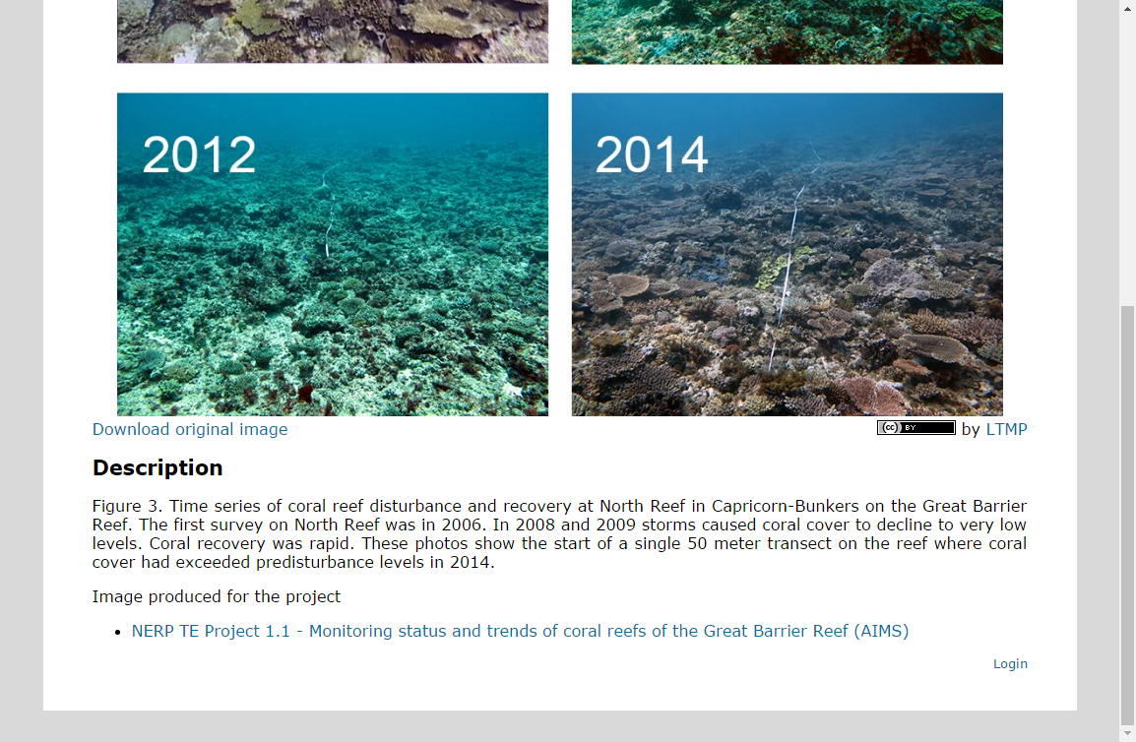
Photos link to their use
Links to articles and projects that use this photo

Slide 22
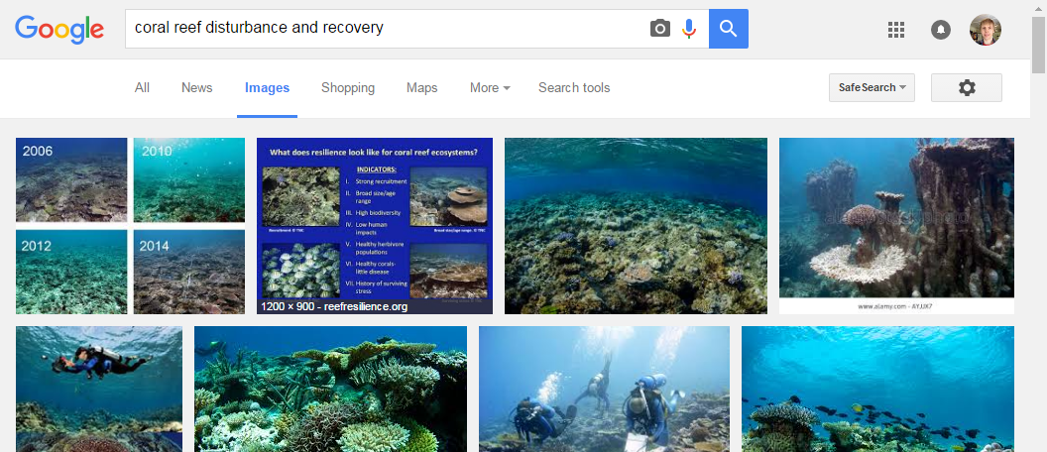
Discoverable in Google
Photo pages provide informative text that makes them search friendly.
Allows more ways for people to find the site directly from Google.
eAtlas page

Slide 23
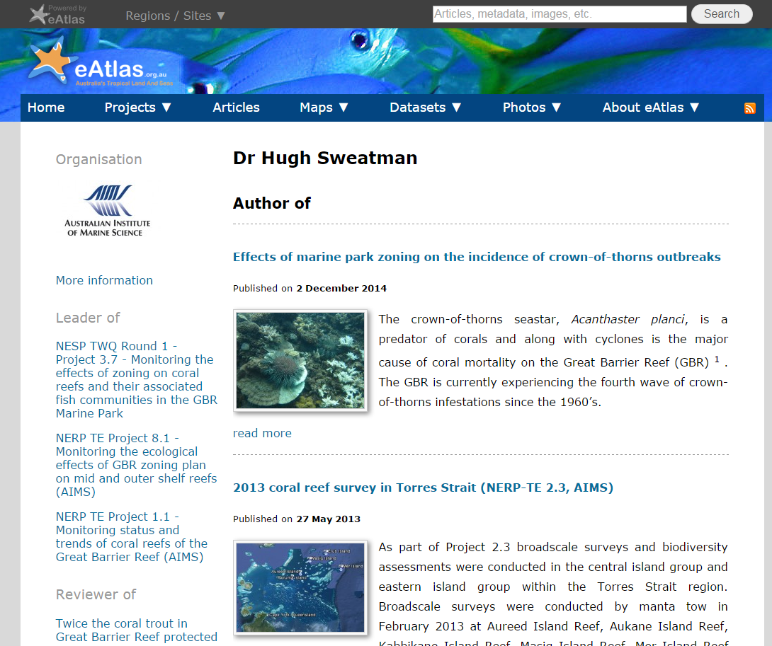
People / Organisations
Cross links all the content from the person or organisation
Can have a bio and photo

Slide 24
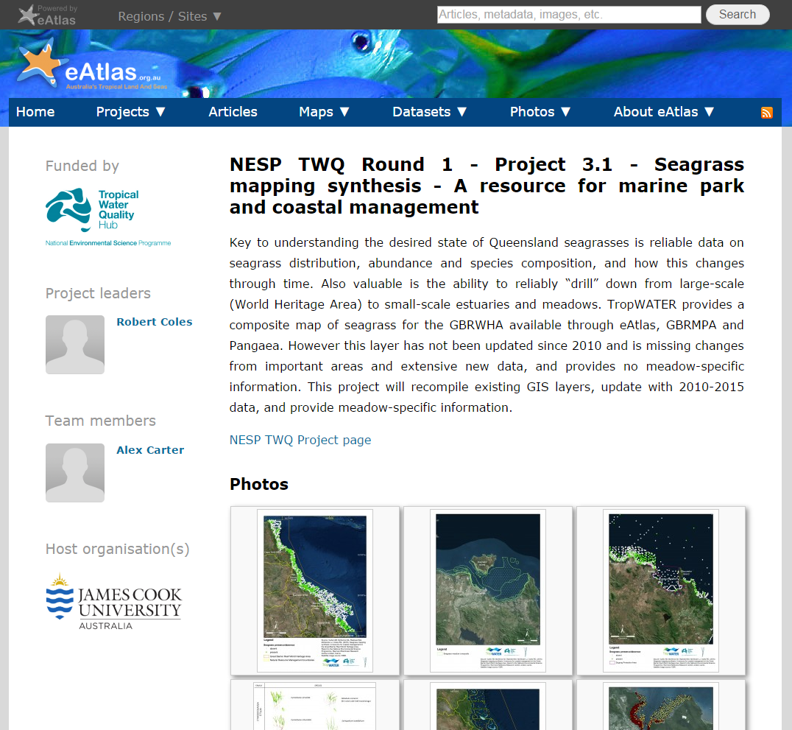
Project pages
Cross links associated people, organisations and content (photos, datasets, articles)

Slide 25
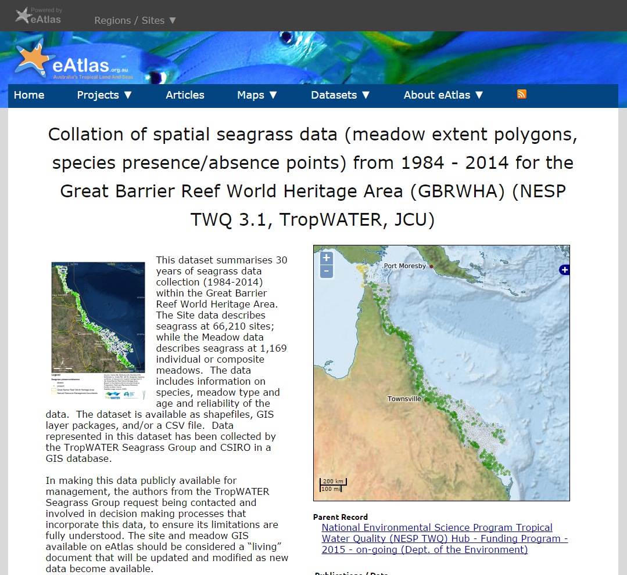
Metadata pages
Detailed technical information needed to reuse the dataset.
Researcher target audience
Links to data downloads and map layers.

Slide 26
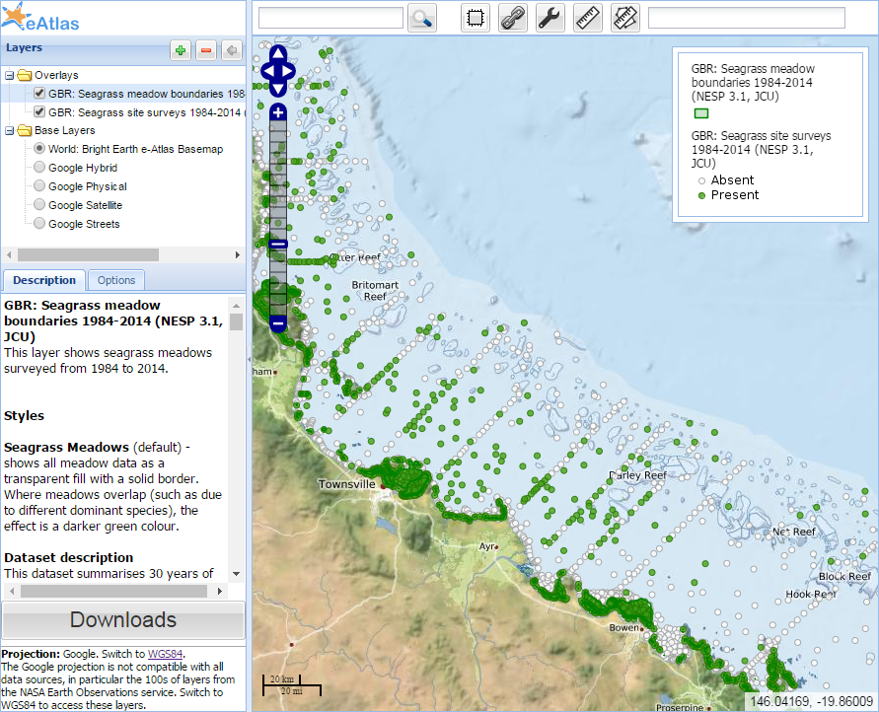
Map layers
Can display and layer any GIS data
Maps can be preconfiged with a combination of layers and styles

Slide 27
Design and Architecture

Slide 28
Design Philosophy
Open data / open source software
Follow national / international standards
Use off-the-shelf software where possible
Use custom software for integration and presentation of content to allow tailoring to stakeholder needs
Provide a curated service to reduce burden on researchers

Slide 29


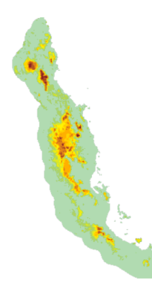
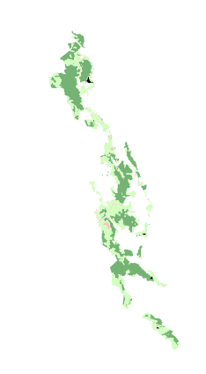
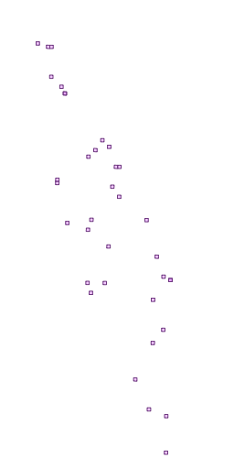







Content Preparation
Systems
System Development
Stories
Map Layers
Data Catalogue
Data
Data documentation
Content
GA
GBRMPA
Collaborate
Prepare data
Data processing Tools
Data, text, images
Data Providers
Content preparation

Slide 30
Key eAtlas systems
Drupal
Content Management System (Website)
GeoServer
Mapping Service
AtlasMapper
Browse map layers and services
GeoNetwork Metadata System
Pydio
File sharing
Stories
Map Layers
Data Catalogue
Data
Data documentation

Slide 31
eAtlas Systems Overview
Private Repository
Public Repository
Content
Management
Metadata
Mapping
eAtlas Repository
File sharing
Web site
Meta-data
Viewer
Web mapping viewer
Setup
AIMS meta-data viewer
AtlasMapper
File system
Pydio
Drupal
Linked public data
Meta-data
Database Server
Mapping server
Off-the-self software
Editor upload
GeoServer, ncWMS, PostGIS
Custom software
GeoNetwork
Desktop GIS
Photo Metadata
ArcMap, QGIS, GDAL
Image Metadata editor
Tools

Slide 32
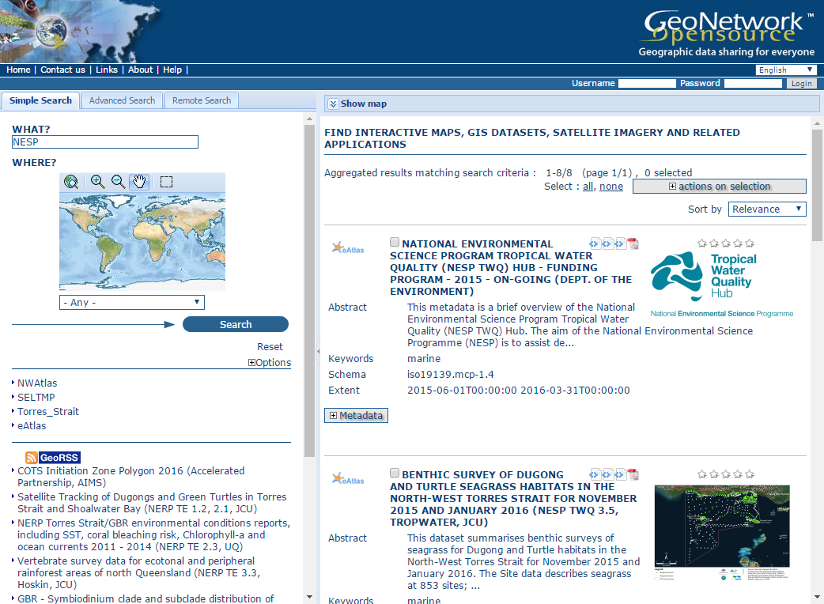
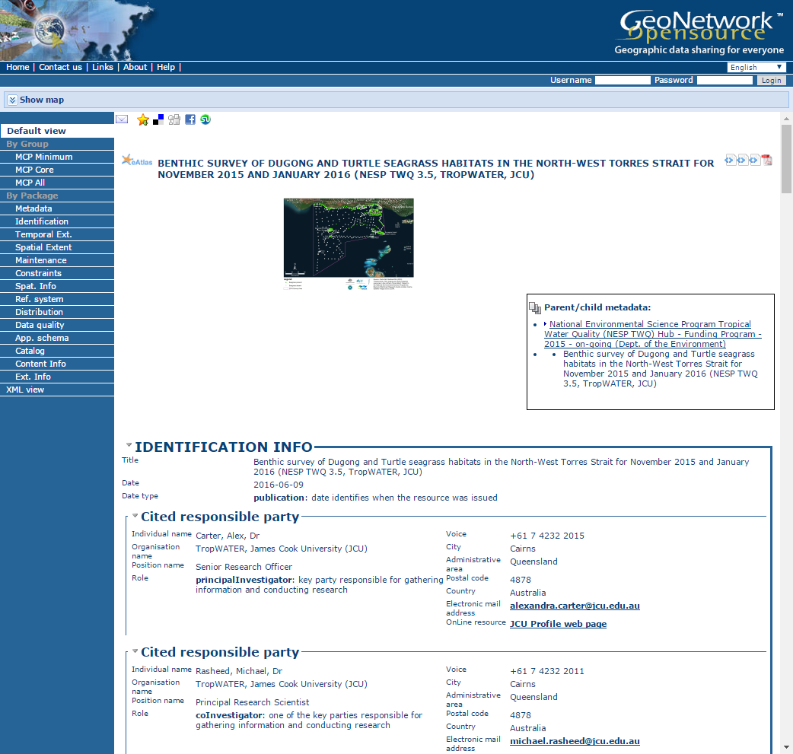
eAtlas metadata system
Contains detailed metadata
Industry standard GeoNetwork software
Only for trained content editors
Provides documentation on datasets, links to data for download
Notes:
These slides are to indicate what to cover in the demonstration.

Slide 33
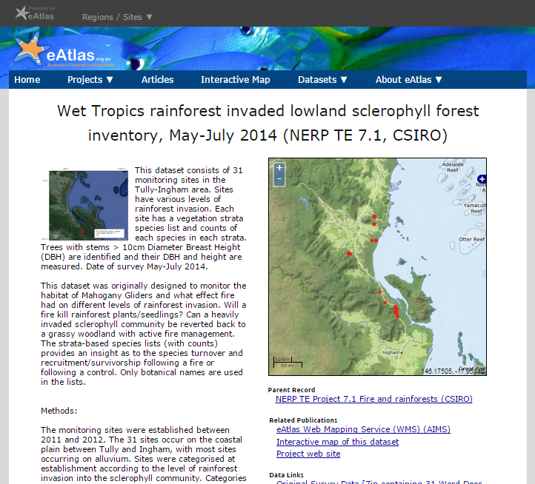
eAtlas metadata system
MetadataViewer (frontend), custom software
Public view
Ensures datasets are discoverable through Google
Notes:
These slides are to indicate what to cover in the demonstration.

Slide 34
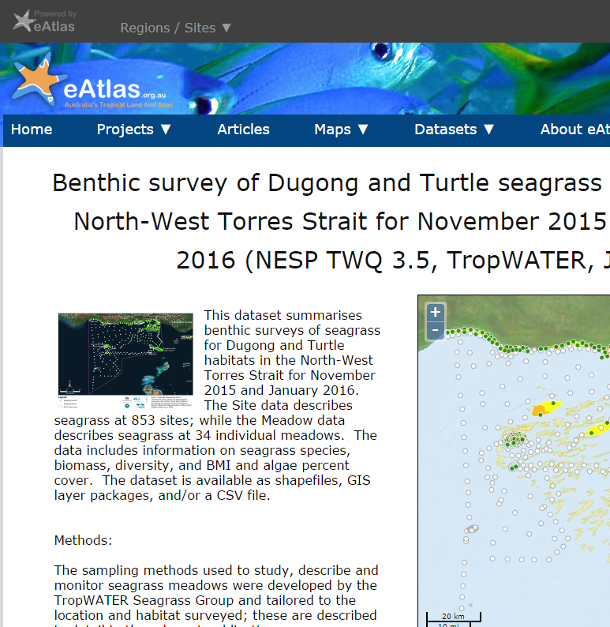
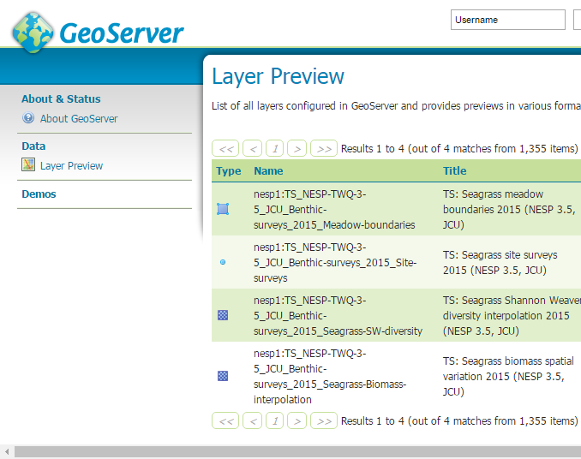
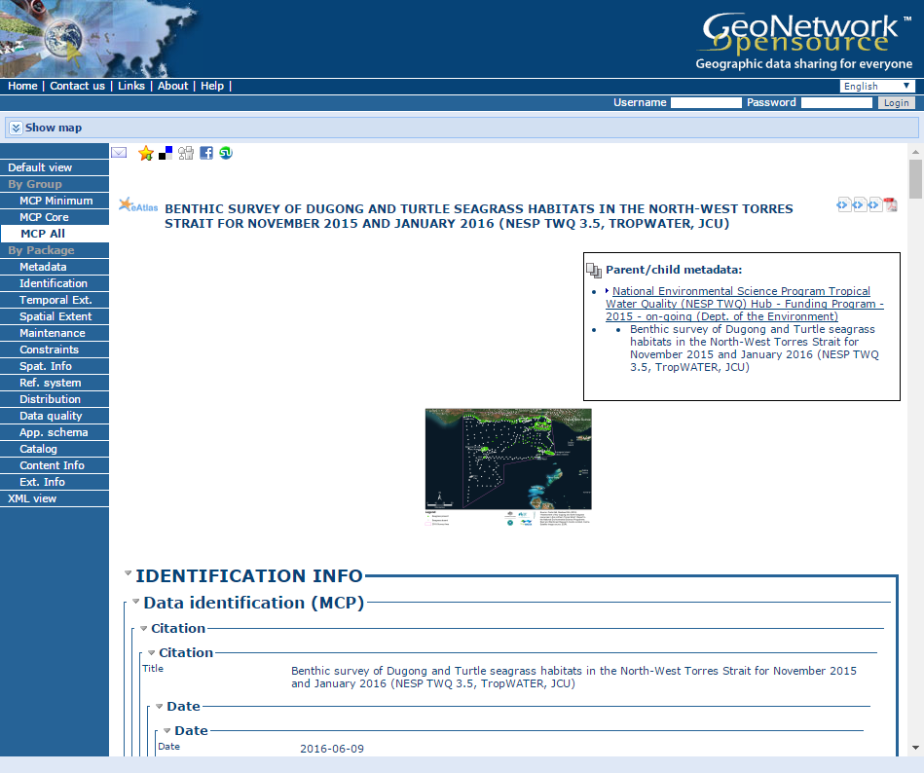
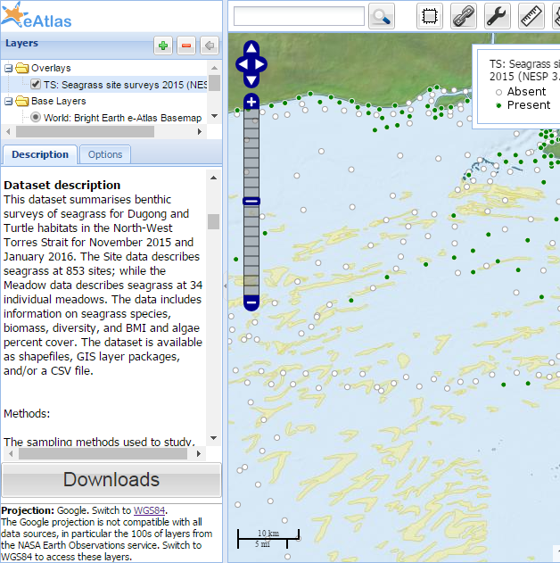
eAtlas Metadata System
Records are exported to Research Data Australia (RDA).
Records are linked from map layers in GeoServer.
RDA
GeoServer
(Backend)
GeoNetwork
(Backend)

Slide 35
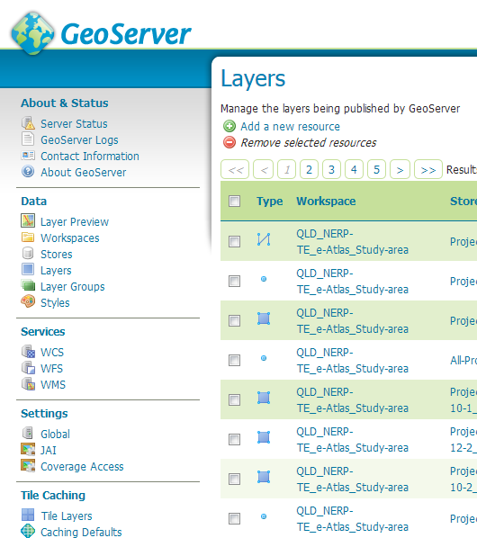
GeoServer
Provides map generation services for the eAtlas.
Makes GIS data files available as web mapping services.
Converts data into images
Each data file becomes a map layer with one or more styles

Slide 36
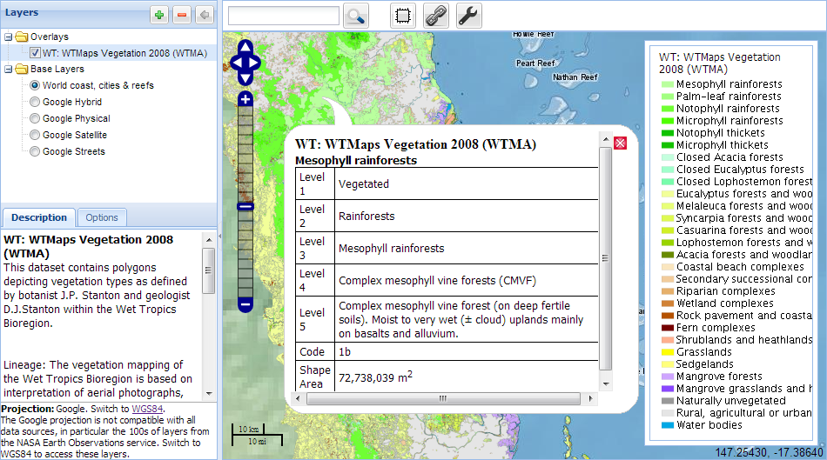
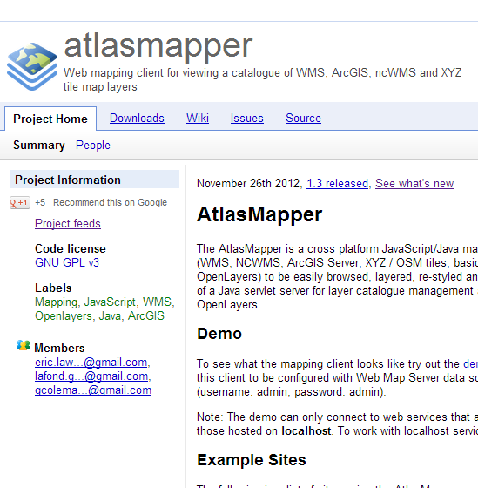
AtlasMapper
Custom web based mapping application
Integrates spatial map services from different sources
Supports multiple mapping standards - WMS, NCWMS, ArcGIS Server, XYZ / OSM tiles, basic KML.
Harvests service capabilities documents to configure all the layers.

Slide 37

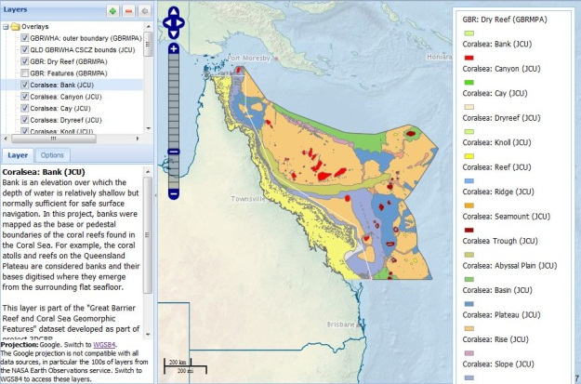
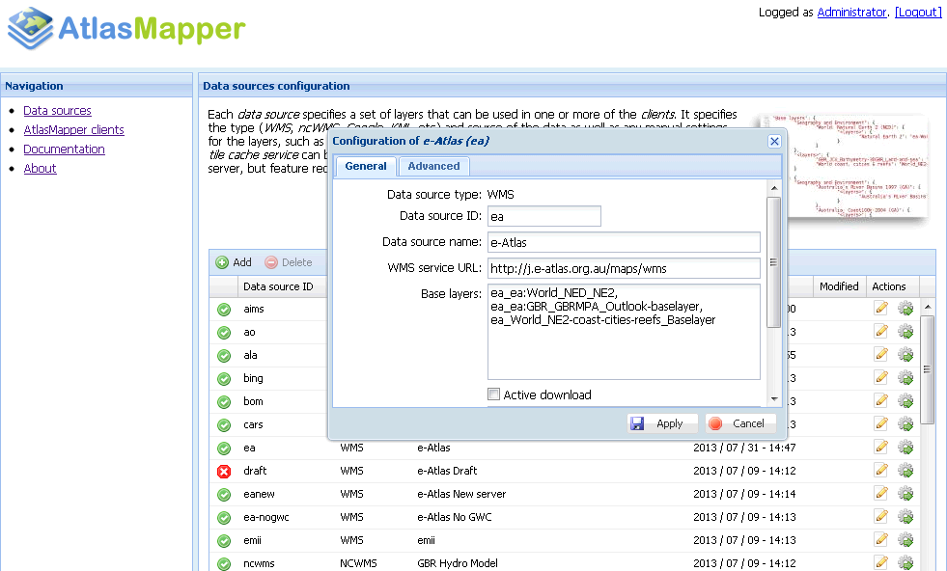
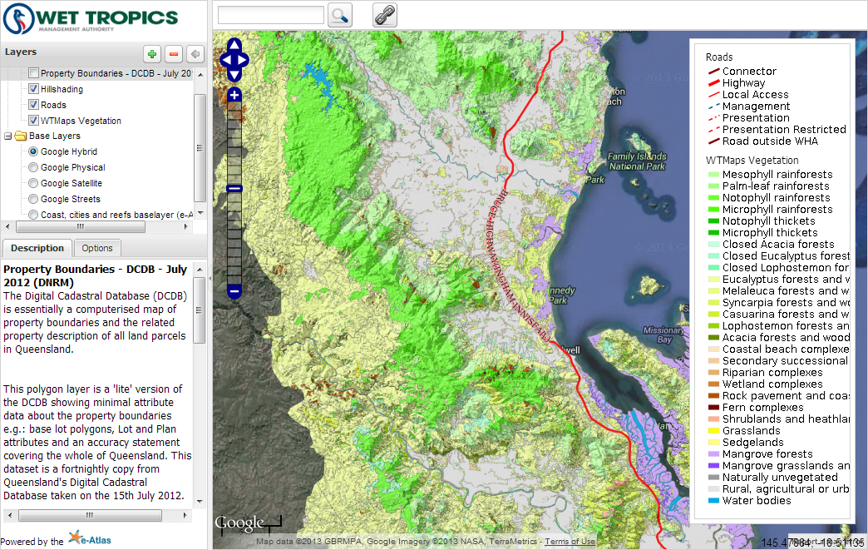
AtlasMapper – Integration of Map Services
Tailored Portals
Region / Topic
AtlasMapper
(eAtlas product)
Linked Metadata
ISO19115
GeoServer
(GIS data)
ArcGIS Server
Basemaps
eAtlas
IMOS
CSIRO
ALA
AIMS
ArcGIS Online
GBRMPA servers
GA
Google
Bing

Slide 38
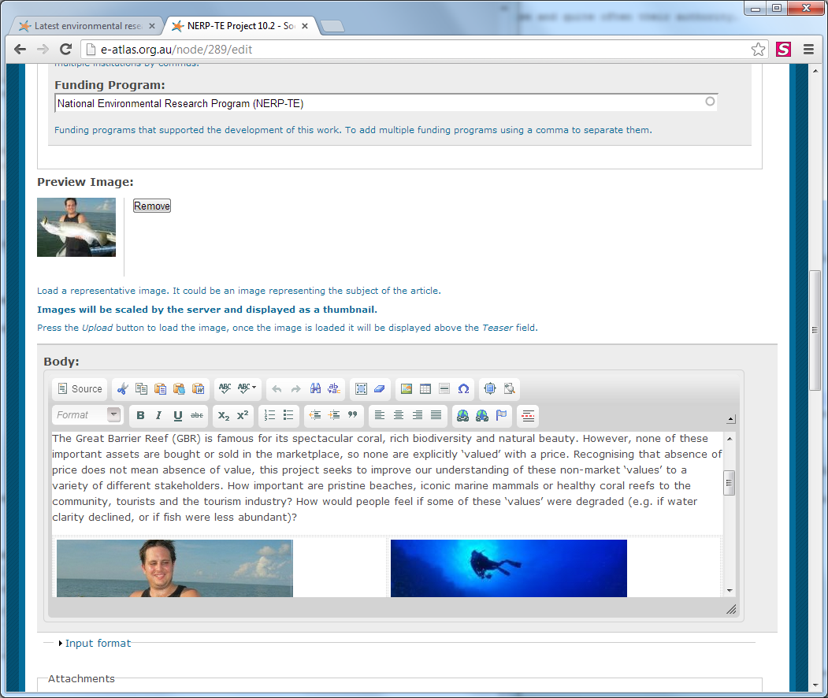
eAtlas Content Management System
Manages:
  Articles
  Project pages
  People / Projects
  Photos/Galleries
  RSS feeds
  Integrated Search (website and metadata)
Based on Drupal 7

Slide 39


Shared Conent – Multi-site branding
Articles, map layers and images can be shared across all eAtlas sites
Each site has custom:
  Branding
  Front page
  Main navigation menu
  Mapping portal
Each site can be maintained by different institution
Share common CMS, GeoNetwork, MetadataViewer.
North West
Atlas
Main
eAtlas
Shared content
Shared
Content
Torres Strait eAtlas
Other eAtlas
Websites
SELTMP

Slide 40
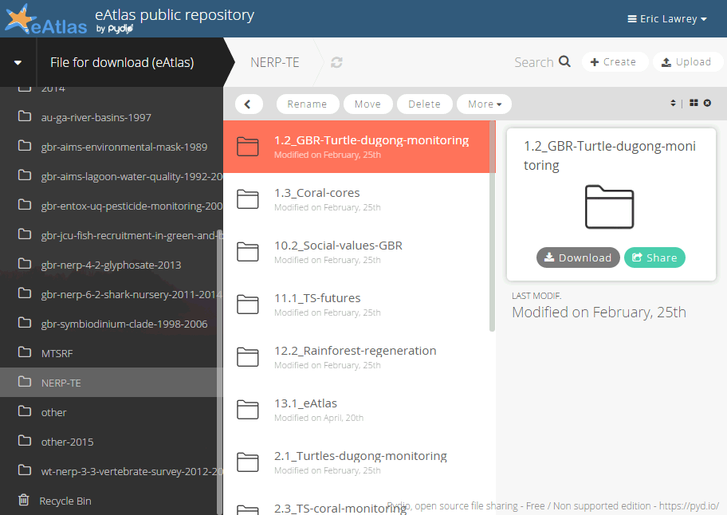
Pydio – Getting files on the server
Pydio – Web based file sharing application
Use it to make it easy for editors to upload to server.
Workspaces for:
  Files for download
  GIS data for GeoServer

Slide 41
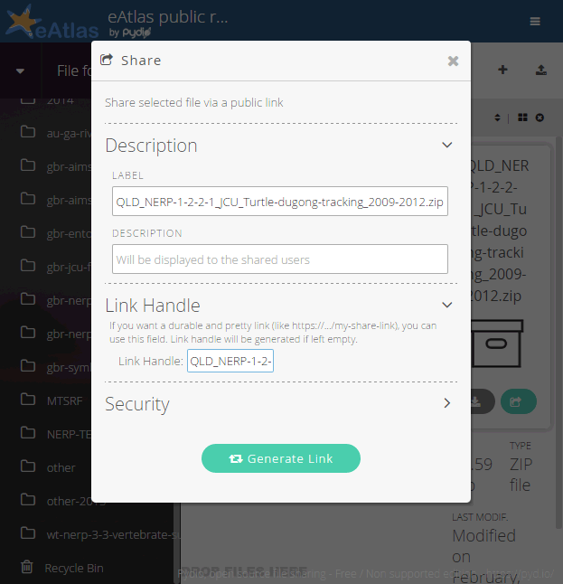
Pydio – Files for download
Includes all content linked from metadata including:
  PDFs
  Zipped Data
Use built in sharing to make files publicly accessible.
Allocate Link Handles matching file name to allow creating of maintainable URLs.

Slide 42
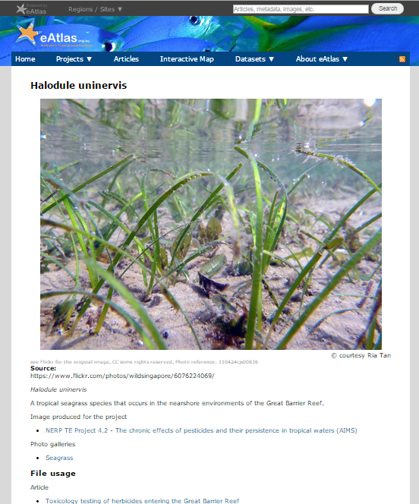
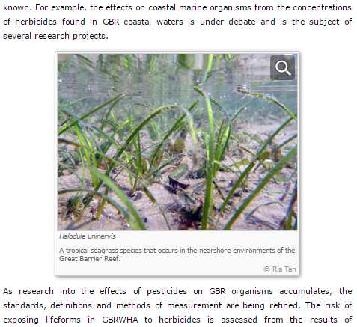
Photo management
Record detailed metadata for photos.
Attribution, licensing, description, useage in site.
Each photos has its own page.

Slide 43
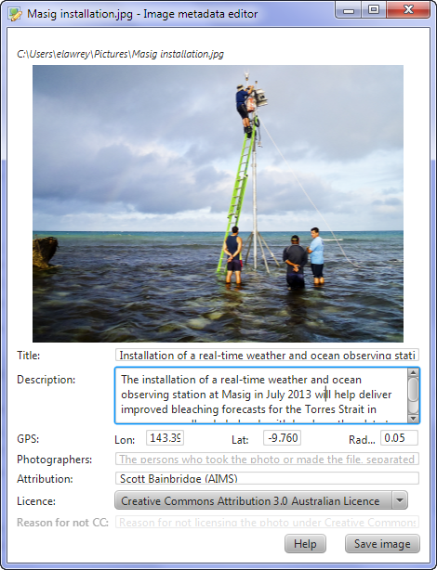
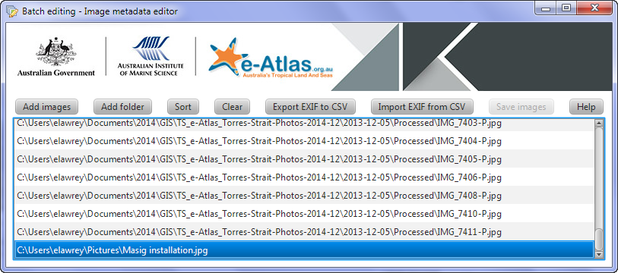
Image Metadata editor
Java application
View and edit metadata, saved in image EXIF
Bulk edit with CSV export and import
Website automatically extracts metadata and links to profiles
Available as part of the eAtlas data tools
Download and documentation:
http://eatlas.org.au/tools/image-metadata-editor

Slide 44
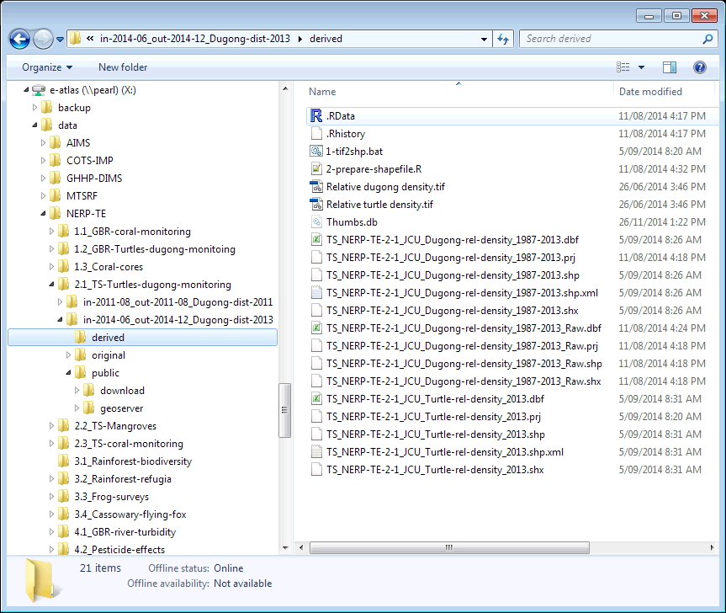
eAtlas Repository
Houses research products and raw data (GIS files, spread sheets, documents, databases, images, etc.)
Intended to ensure data is useable in 20+ years without eAtlas servers
Multi-site backup and disaster recovery system
Simple file repository
Convention based curation
Not web accessible
Intended to one-off datasets, not near-real time data

Slide 45
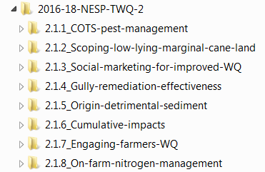
eAtlas Repository
Projects and datasets have a naming convention
Projects:
  {Program year start}-{Program year end}-{Program abbreviation}
    {Project code}_{Short name of project}
Datasets
  {Region code}_{Institution}_{Dataset short description}_{Years}
  Examples:
    GBR_CSIRO-AIMS_Seabed-biodiversity_2003-2006
    AU_AIMS_Marine-Parks-AMPSA_2018
    AU_GA_Bathymetry_2009
    World_NASA_BlackMarble_2012-2016
    GBR_GBRMPA_GBR-features_2015
  Dataset name is also used in setting up map layer names, download files, etc.

Slide 46

eAtlas Repository
The repository is split into:
  Custodian – responsible for long term curation
  Non-custodian – from external public sources that are made available on the eAtlas as reference data (in-effect republished)
  Other-unpublished – Collection of external public data that has not been used yet.

Slide 47


eAtlas Repository
Organised by research program and custodian institution.
Captures the workflow for each dataset
Retain old versions
For projects
  Folders for each content type: reports, images, plans, etc
For submitted datasets:
  Original – As submitted files
  Derived – Modifications, reformatted files, documentation improvements
  Public – Files suitable for public download.
For own created datasets:
  Source – Original datasets used as part of this new dataset
  Working – Working directory containing intermediate generated files.
  Derived – Alternate modifications of the core dataset
  Published – Published form of the dataset
  Deprecated – Trash can of old files that we are pretty sure we don't need. Helps clean up the folder without the worry of loosing something

Slide 48
Barriers to sharing of data
Sharing of data is typically a low priority and an after thought.
Barriers to openly sharing research data:
Questionable reasons:
  competitive research environment
  careers based on a dataset
  poor data documentation
  lack of licensing awareness
  fear of misuse of data
  pressure to publish - embargo
Legitimate reasons for restrictions
  privacy concerns
  protection of sensitive environments
Limited data sharing slows our ability to capture research and make it useful for management.

Slide 49
Creating new datasets

Slide 50


New dataset – Keep a journal
Can be a short text file – processing.txt
Or longer if there are more steps

Slide 51

New dataset – Keep a journal
Can be a Word document with screenshots
Keys are:
Providence of the source data.
Recording the processing steps used to create the dataset.
Not a metadata record, but a great starting point.

Slide 52


New dataset - Make filename match journal steps
Link processing steps with generated files using step number.
Allows picking up / checking the processing from an intermediate step.

Slide 53
Publishing datasets

Slide 54
eAtlas publishing workflow
Projects are taken through:
  Data discussion – one-on-one discussion about expected data products expected from the project. Early in the project.
  Data management plan – Record of how data will be used in the project and more detail of expected data. Mid way through project.
  Final data submission – Complete a dataset report. Team reviews the submission, data and documentation. Queries data provider for more information when needed. All information is recorded in the metadata record.
  Spatial data is visualised in map portal for allow users to quickly understand the scope of the dataset.

Slide 55
Dataset report
eAtlas Dataset Report
  Captures documentation about datasets without users needing to know ISO19115.
  Multiple fields in the template are all put in the metadata abstract.
  We review the submitted report and data then convert to ISO19115/19139 MCP 2.0 records.

Slide 56

Thank You
The content of this presentation is made available under a Creative Commons Attribution 3.0 Australia license, except for the logos. These trademarks are used with permission from their respective owners.
© Eric Lawrey, eAtlas, AIMS

